Slide 1
Supporting young people’s AI programming
Niall Winters (in collaboration with Ken Kahn)
Learning and New Technologies Group
Department of Education, University of Oxford
niall.winters@education.ox.ac.uk | @nwin
11th Workshop of Knowledge Management & E-Learning
Advanced Innovation Center for Future Education, Beijing Normal University
24-25 June 2019

Slide 2
What have we done?
Extending block programming languages to allow young people to:
Explore artificial intelligence (AI) concepts
Build their own AI programmes
Developing an associated curriculum (on-going)

Slide 3
Why?

Slide 4
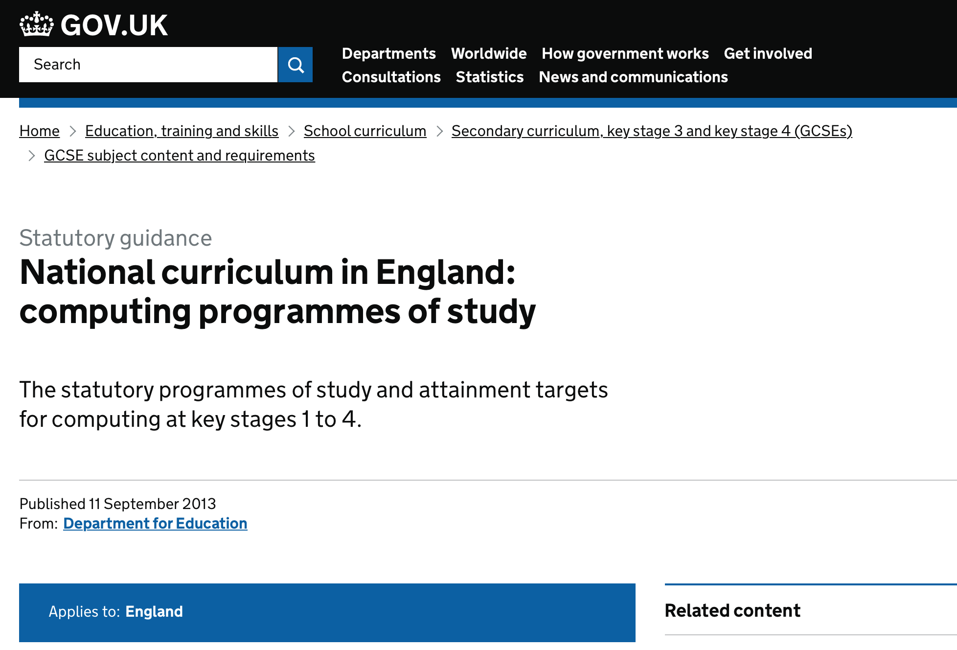

Slide 5
https://snap.berkeley.edu

Slide 6
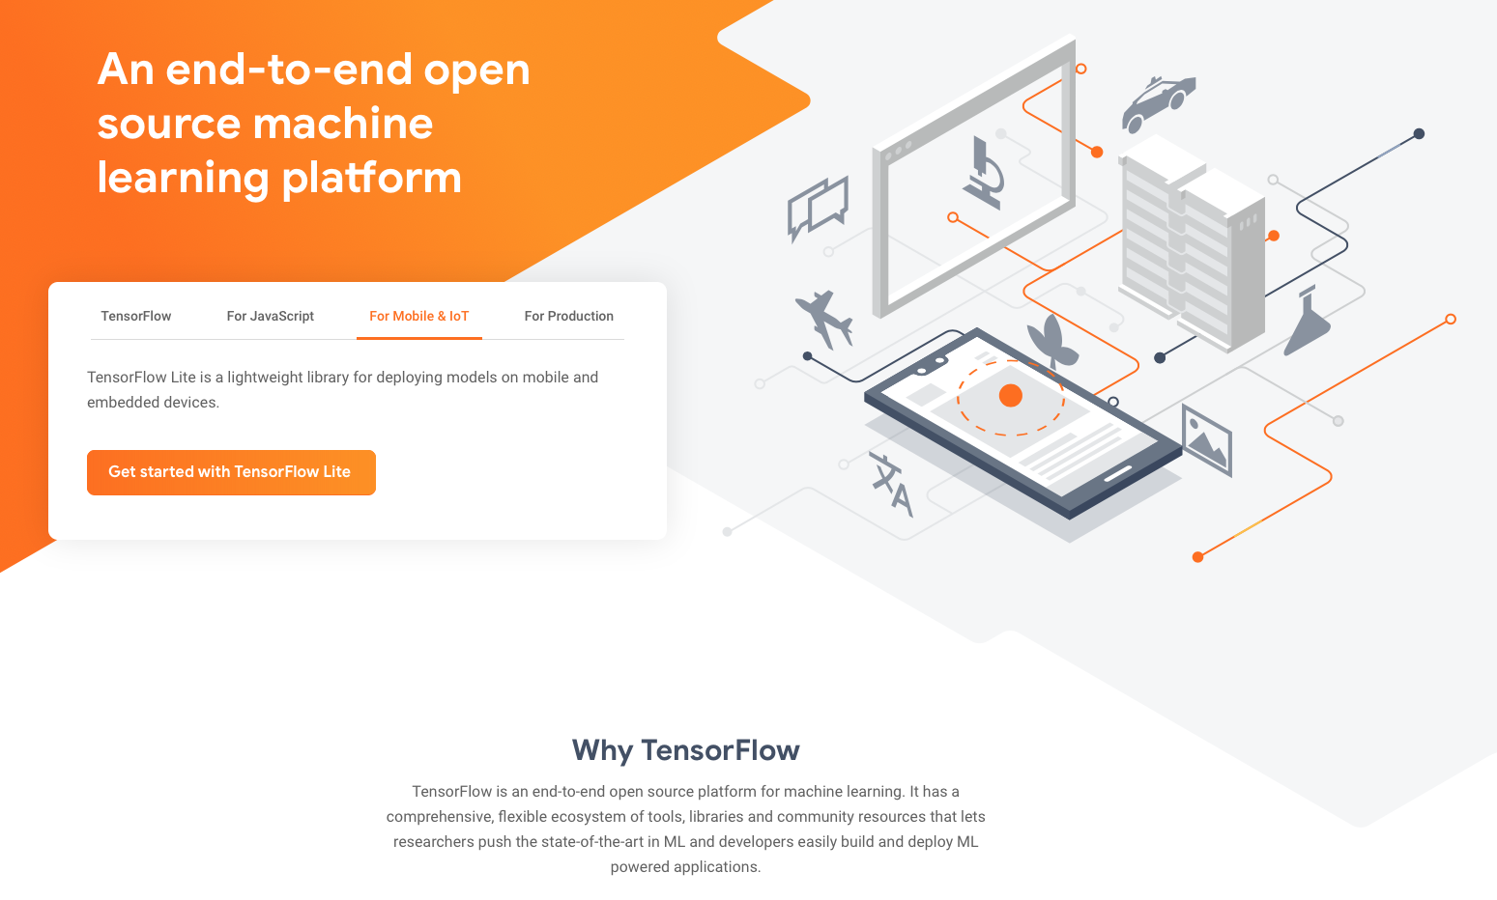

Slide 7
Changing Minds: Computers, Learning, and Literacy Andrea A. DiSessa
Similar history of introduction of Algebra and Calculus to schools and colleges

Slide 8
China’s top 5 AI companies (WEF)
DJI (drones)
Ubtech (robotics)
SenseTime (image recognition)
Cambricon (chips)
Cloudwalk (face recognition)

Slide 10
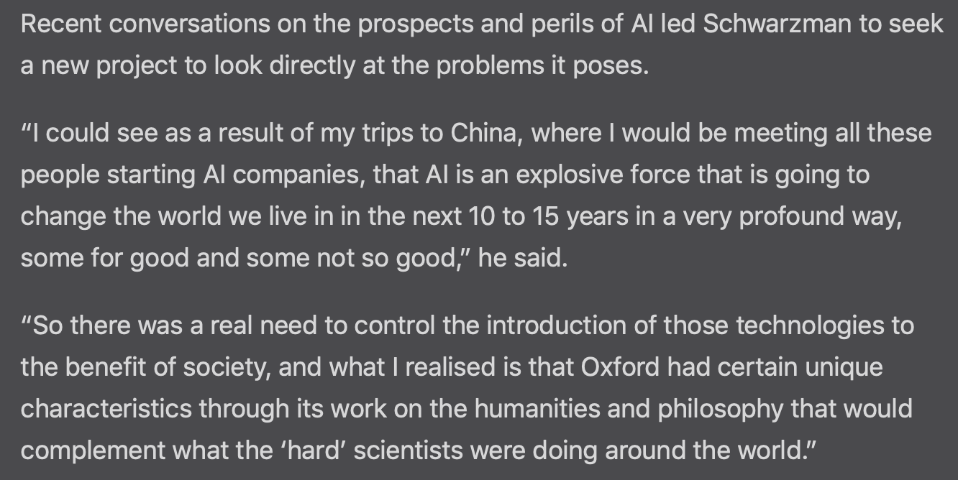

Slide 11
Why help young people to create AI programs?
Students may learn about cloud services, machine learning, artificial intelligence, and other advanced technologies that are changing the world
Students may learn about perception, reasoning, psychology, and animal behavior in the process of building perceptive robots and apps
Students can see how AI could be used to help people (assist those with disabilities, improve medicine, help in emergencies) as well as risks
Students may reflect more deeply upon their own abilities to hear, see, and respond appropriately
Students may become better motivated and empowered to produce very capable artefacts

Slide 12
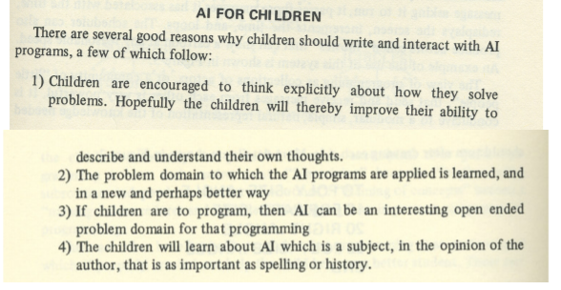
From 1977
Three Interactions between AI and Education

Slide 13
Today there is a revival
Machine Learning for Kids, Dale Lane, April 17 2017
Machine Learning for Middle Schoolers, Stephen Wolfram, May 11 2017
Google’s AIY Project, May 2017
Child-friendly Programming Interfaces to AI Cloud Services, Ken Kahn and Niall Winters, September 16, 2017
Google’s Teachable Machine, October 2017
Cognimates Studio, Stefania Druga and other MIT Media Lab students
A bit of cs4fn, Queen Mary University of London
AIinSchools, Beverly Clarke, 15 June 2018
Machine Learning for Good, Apps for Good, 3 August 2018
AI for K-12 Initiative, 20 October 2018
International Workshop on Education in Artificial Intelligence K-12, August 2019
And there is lots more.

Slide 14
Plenty of AI cloud services
Google’s machine learning services
IBM Watson cloud services
Microsoft Cognitive Services
Amazon AI Services
Alibaba’s ET BRAIN

Slide 15
But AI cloud service interfaces are complex
Designed for use by professional programmers
$(function() {
var params = {
// Request parameters
"visualFeatures": "Categories",
"details": "{string}",
"language": "en",
};
$.ajax({
url: "https://westus.api.cognitive.microsoft.com/vision/v1.0/analyze?" + $.param(params),
beforeSend: function(xhrObj){
// Request headers
xhrObj.setRequestHeader("Content-Type","application/json");
xhrObj.setRequestHeader("Ocp-Apim-Subscription-Key","{subscription key}");
},
type: "POST",
// Request body
data: "{body}",
})
.done(function(data) {
alert("success");
})
.fail(function() {
alert("error");
});
});

Slide 16
The challenge - create child-friendly interfaces
Why do this in Snap!?
Is a powerful language
Is a superset of the popular Scratch language
Is easy to extend without touching the source code
Runs in every modern browser
Can connect to Arduinos and Raspberry Pis
Is free open source software

Slide 17
And machine learning without cloud services
Tensorflow.js appeared in 2018
It supports training and prediction in the browser (uses the GPU)

Slide 18
Current work: eCraft2Learn Snap! library

Slide 19
Introduction to https://ecraft2learn.github.io/ai/
Teachers Guide walkthrough
Rock / Paper / Scissors and Intro to neural nets
Child-friendly programming interfaces to AI cloud services, Proceedings of EC-TEL 2017: Data Driven Approaches in Digital Education, 10474, 566-570, 2017
Deep Learning Programming for All (Kahn, Lu, Zhang, Winters, Gao; to appear) IJCAI 2019, Macau, China

Slide 20
Thanks!
The Snap! programs are available at ecraft2learn.github.io/ai/
This research was supported by the eCraft2Learn project funded by the European Union’s Horizon 2020 Coordination & Research and Innovation Action under Grant Agreement No 731345.

