Slide 1
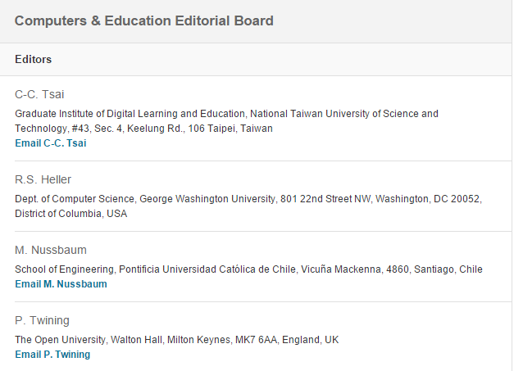
Miguel Nussbaum mn@ing.puc.cl
Pontificia Universidad Católica de Chile
2018: IF: 5.627, Rank #3 /243
My experience as co-editor of Computers & Education

Slide 2
General
Defined problem:
within the scope of the Journal
too specialized
Bibliograpahy updated 15 (at least) refereed papers last 3 years
Match with papers in Internet
Long and difficult to follow
Appendix
English
Proofread by English native professional
Define acronyms before using these (none in Abstract)
APA guidelines on:
Reporting statistics
Bibliography
Resubmission
accompanying letter analyzing how you addressed each of the referees points.

Slide 3
Abstract
What is the problem?
What have you done?
What are your results?
What have you learned?
(250 words)

Slide 4
General Structure
Define the problem, aim and research questions based on current significant literature
Detailed methodology.
Results provide data to answer the research questions.
Conclusion and Discussion
Based on results
Discussed considering pertinent literature
https://owl.english.purdue.edu/owl/resource/560/01/

Slide 5
Introduction
Literature Review:
Relevant to the problem
Updated
Comprehensive
Of the literature review a cohesive history has to be written (not just a list of paragraphs from references).
Build Reserach Questions from literature review
RQ should be of global interest and not focused to a particular local problem
Identifying a research gap is not enough; key is showing its significance to the field.
Why is your research relevant?
What did we learn compared with current, significant research

Slide 6
Methodology
Research Design: funded in literature:
quanti, quali, mixed
Design Based Research
Educational Context
Representative of what?
Sample has to be far-reaching to be representative to reach conclusions
Quantitative results from a small number of students can be inconclusive.
System used:
Purpose and design goals,
description (not a manual),
usability.
Instruments:
Analyze and fundament,
Show validity and statistical reliability
Data has to match objectives (Dependent and independent variables)
Procedure:
Index of results
Treatment and control group have to be comparable
Protocol for interviews and observations
Strong Statistical methods
http://authors.elsevier.com/sd/article/S0360131515001463
Qualiatative analysis
http://www.sciencedirect.com/science/article/pii/S0360131516302445
f) How general are your results?

Slide 7
Results
Follow your procedure described in the methodology.
Results provide answers to your questions.
Discusion
Analyze results considering pertinent literature.
Make explicit suggestions about how the study affects the design or use of educational computer systems.
Is there something new about a particular theory, or is there evidence of theory advancement?
Conclusion
Answer your research questions based on the results.
What is the added value of your work?
Conclusions general enough to be interesting for a wider audience.
Limitations
Future work

Slide 8
Review papers
Research gaps it fills (why do we need your review (one more)?)
Systematic and rigorous, based on a state of the art study (significant papers up to 2019)
Clear meta-analysis and synthesis (no narrative review)
Show added value with references.
Theoretically and critically analyzed.
Justify bibliographically
paper selection
descriptors
Summarize findings
http://prisma-statement.org

