Slide 1
Intelligent Tutoring System: The importance of the Inner Loop
Prof. Seiji Isotani
University of Sao Paulo
sisotani@icmc.usp.br

Slide 2
Intelligent Tutoring Systems (ITS)

Slide 3
A Definition
Intelligent Tutoring System (ITS) is a software developed to Interact with students and teachers via its interface presenting intelligent behaviors to adapt and personalize learning. Furthermore, it offers step-by-step support during problem solving to address students needs and difficulties.

Slide 4
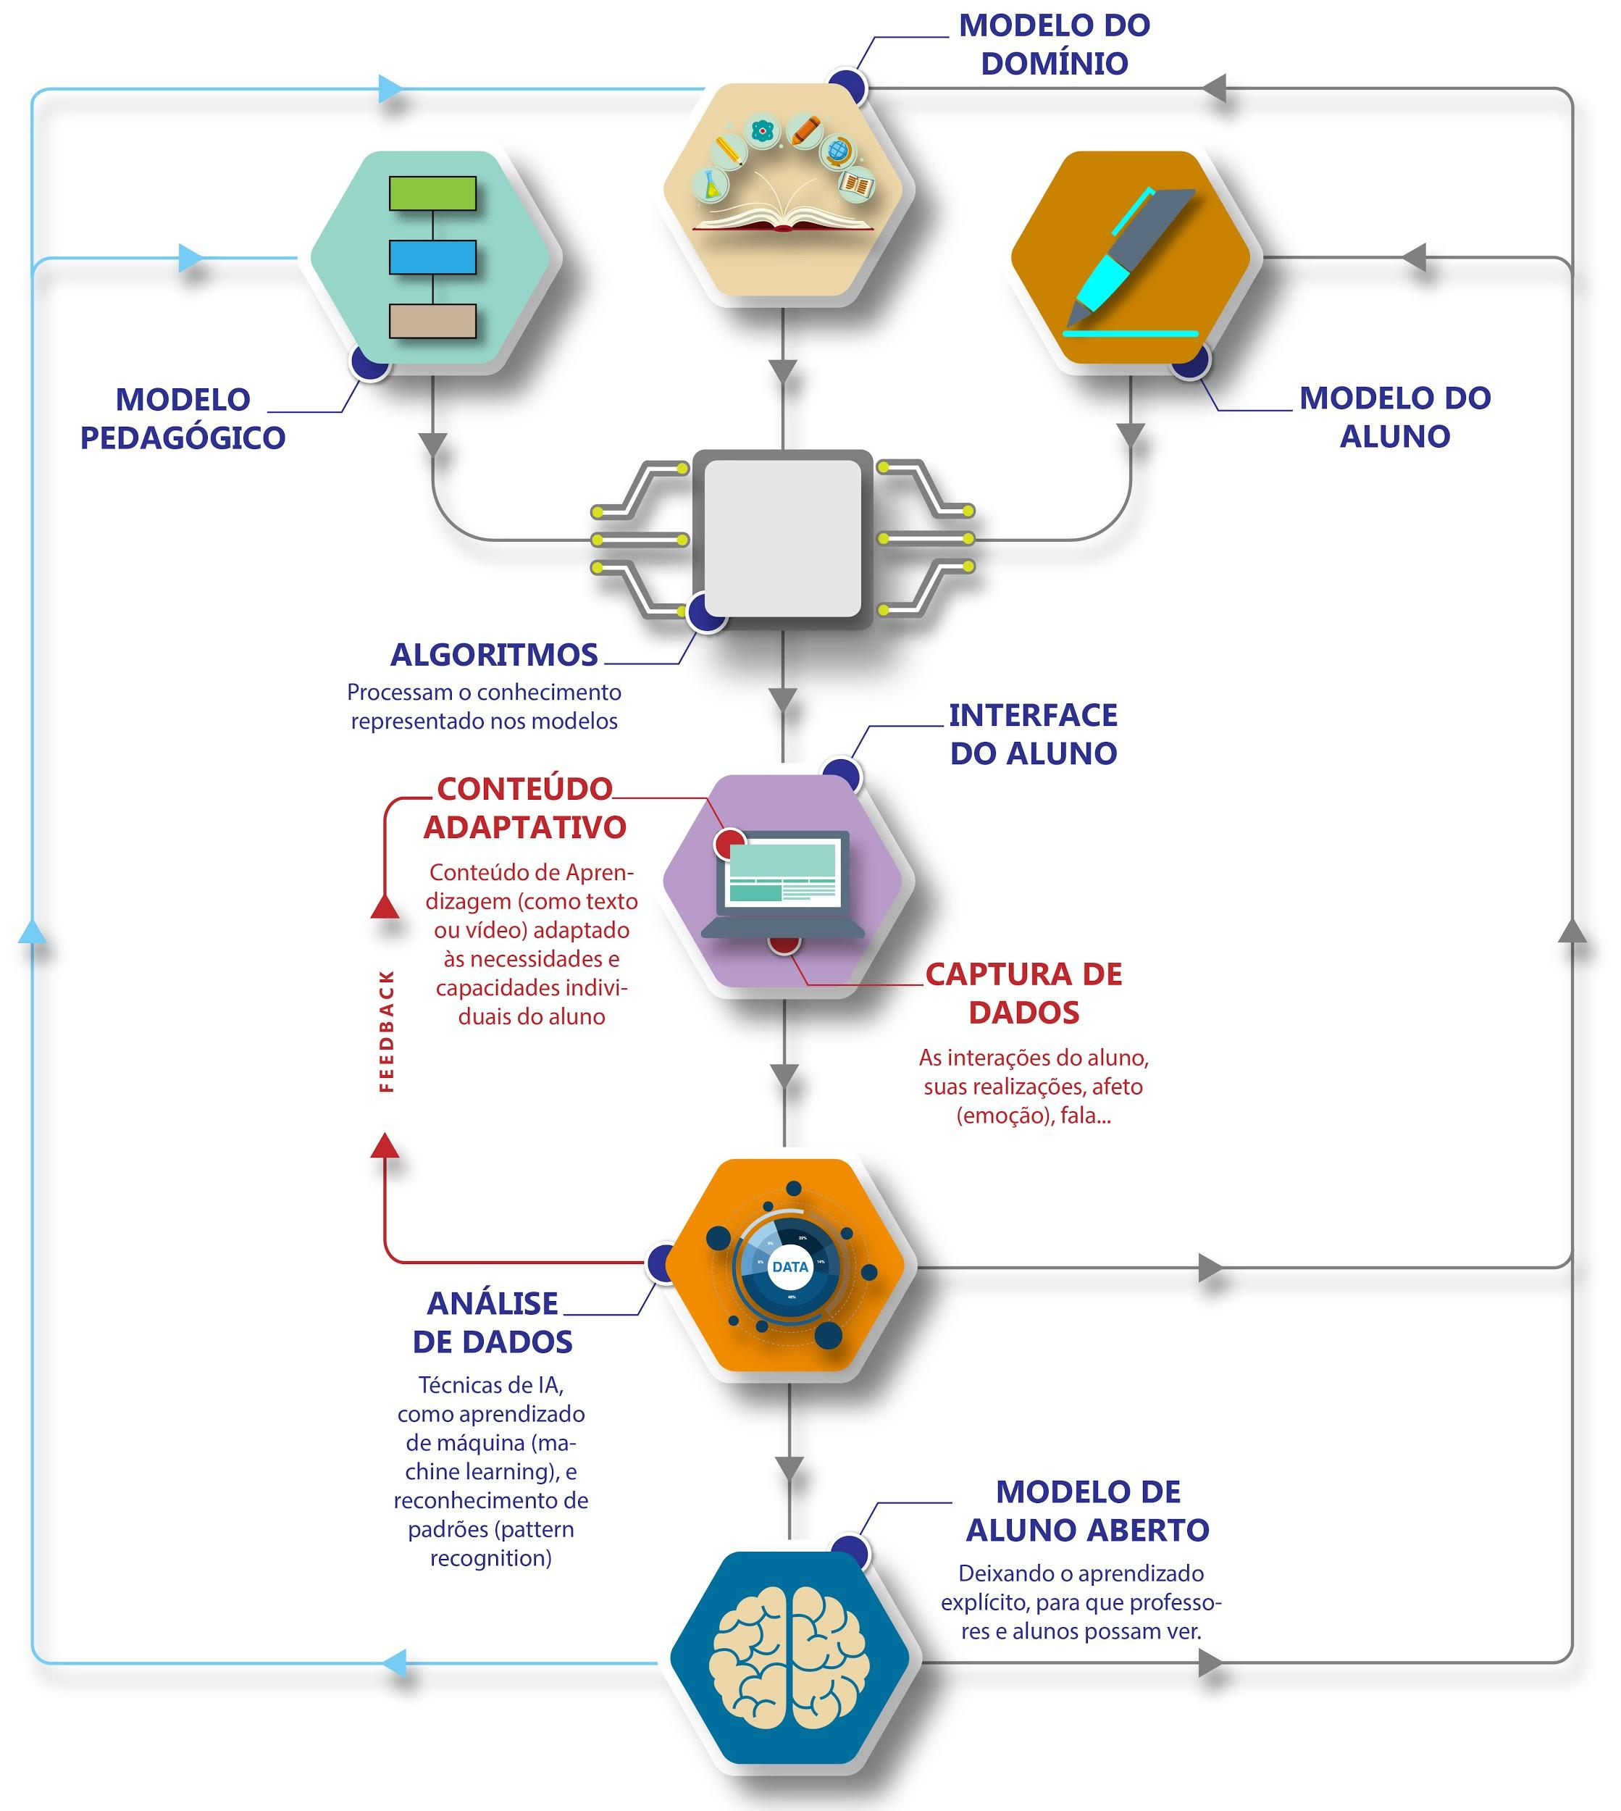
DOMAIN MODEL
PEDAGOGICAL MODEL
STUDENT
MODEL
ALGORITHMS
USER INTERFACE
ADAPTIVE
CONTENT
ITS ARCHITECTURE
DATA COLLECTION
DATA ANALYSIS
OPEN LEARNER MODEL
Notes:
Início do 5o vídeo

Slide 5
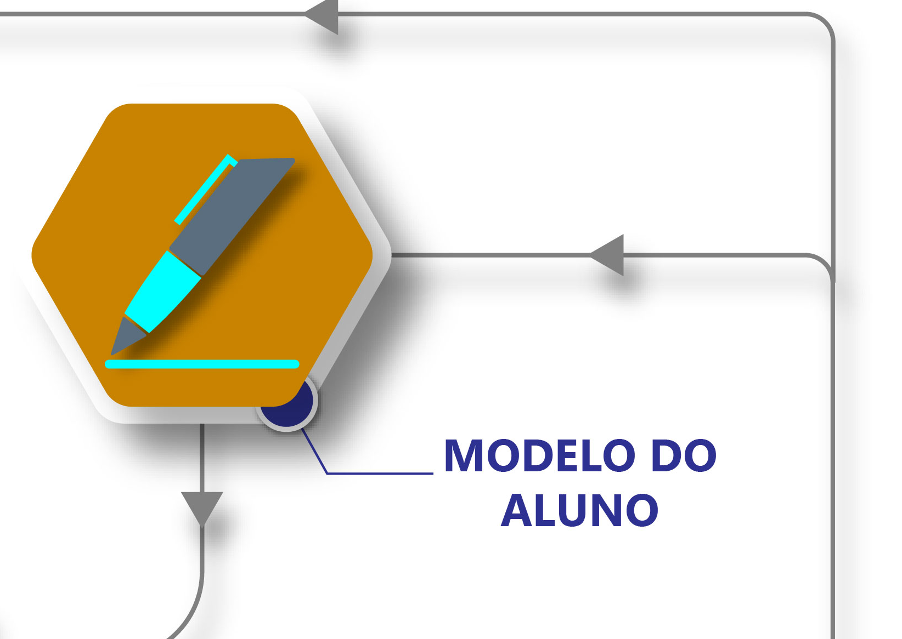
DOMAIN MODEL
PEDAGOGICAL MODEL
STUDENT
MODEL
STUDENT
MODEL
ALGORITHMS
USER INTERFACE
ADAPTIVE
CONTENT
ITS ARCHITECTURE
DATA COLLECTION
DATA ANALYSIS
OPEN LEARNER MODEL
Notes:
Início do 5o vídeo

Slide 6
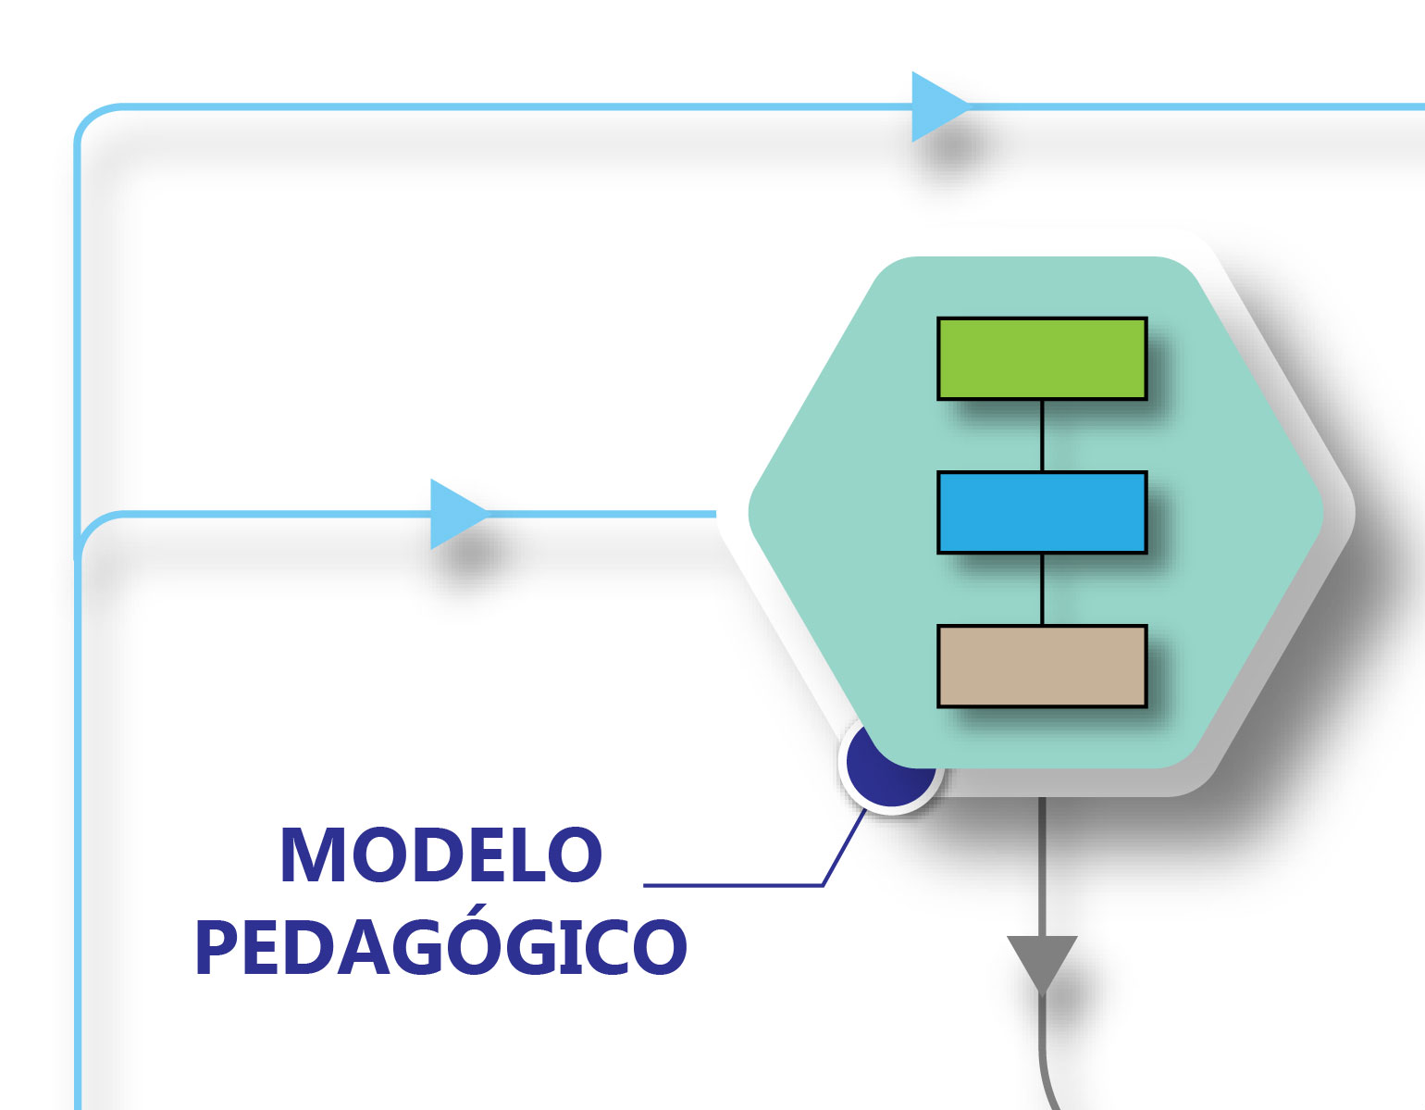
DOMAIN MODEL
PEDAGOGICAL MODEL
STUDENT
MODEL
PEDAGOGICAL MODEL
ALGORITHMS
USER INTERFACE
ADAPTIVE
CONTENT
ITS ARCHITECTURE
DATA COLLECTION
DATA ANALYSIS
OPEN LEARNER MODEL
Notes:
Início do 5o vídeo

Slide 7
DOMAIN MODEL
DOMAIN MODEL
PEDAGOGICAL MODEL
STUDENT
MODEL
ALGORITHMS
USER INTERFACE
ADAPTIVE
CONTENT
ITS ARCHITECTURE
DATA COLLECTION
DATA ANALYSIS
OPEN LEARNER MODEL
Notes:
Início do 5o vídeo

Slide 8
DOMAIN MODEL
PEDAGOGICAL MODEL
STUDENT
MODEL
ALGORITHMS
USER INTERFACE
ADAPTIVE
CONTENT
ITS ARCHITECTURE
DATA COLLECTION
DATA ANALYSIS
OPEN LEARNER MODEL
Notes:
Início do 5o vídeo

Slide 9
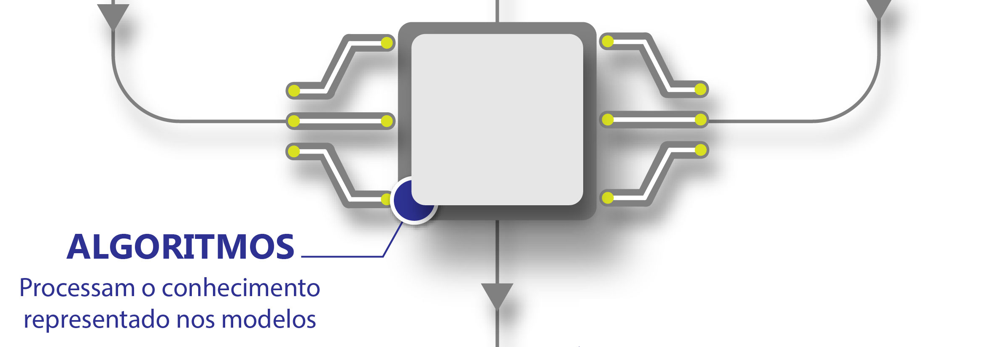
DOMAIN MODEL
PEDAGOGICAL MODEL
STUDENT
MODEL
ALGORITHMS
USER INTERFACE
ADAPTIVE
CONTENT
ITS ARCHITECTURE
ALGORITHMS
DATA COLLECTION
DATA ANALYSIS
OPEN LEARNER MODEL
Notes:
Início do 5o vídeo

Slide 10
DOMAIN MODEL
PEDAGOGICAL MODEL
STUDENT
MODEL
ALGORITHMS
USER INTERFACE
ADAPTIVE
CONTENT
ITS ARCHITECTURE
DATA COLLECTION
DATA ANALYSIS
OPEN LEARNER MODEL
Notes:
Início do 5o vídeo

Slide 11
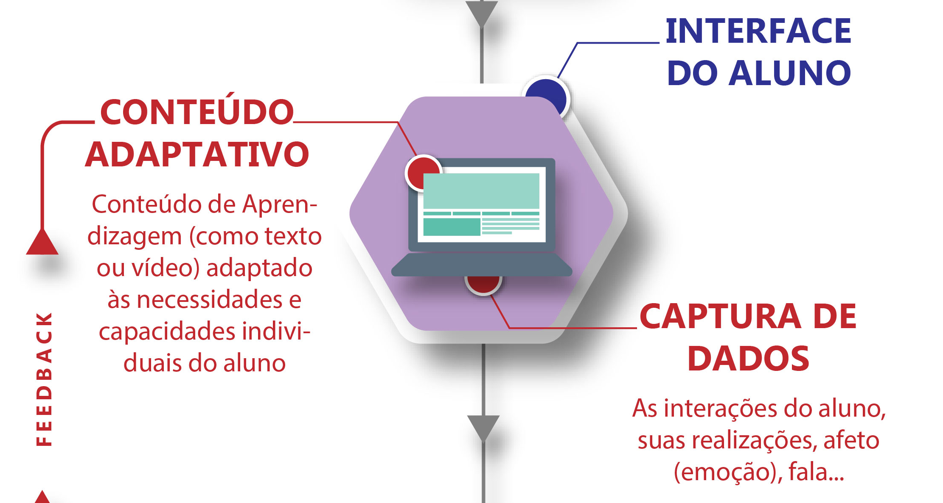
DOMAIN MODEL
PEDAGOGICAL MODEL
STUDENT
MODEL
ALGORITHMS
USER INTERFACE
USER INTERFACE
ADAPTIVE
CONTENT
ITS ARCHITECTURE
ADAPTIVE
CONTENT
DATA COLLECTION
DATA COLLECTION
FEEDBACK
DATA ANALYSIS
OPEN LEARNER MODEL
Notes:
Início do 5o vídeo

Slide 12
DOMAIN MODEL
PEDAGOGICAL MODEL
STUDENT
MODEL
ALGORITHMS
USER INTERFACE
ADAPTIVE
CONTENT
ITS ARCHITECTURE
DATA COLLECTION
DATA ANALYSIS
OPEN LEARNER MODEL
Notes:
Início do 5o vídeo

Slide 13
DOMAIN MODEL
PEDAGOGICAL MODEL
STUDENT
MODEL
ALGORITHMS
USER INTERFACE
ADAPTIVE
CONTENT
ITS ARCHITECTURE
DATA COLLECTION
DATA ANALYSIS
DATA ANALYSIS
OPEN LEARNER MODEL
Notes:
Início do 5o vídeo

Slide 14
DOMAIN MODEL
PEDAGOGICAL MODEL
STUDENT
MODEL
ALGORITHMS
USER INTERFACE
ADAPTIVE
CONTENT
ITS ARCHITECTURE
DATA COLLECTION
DATA ANALYSIS
OPEN LEARNER MODEL
Notes:
Início do 5o vídeo

Slide 15
DOMAIN MODEL
PEDAGOGICAL MODEL
STUDENT
MODEL
ALGORITHMS
USER INTERFACE
ADAPTIVE
CONTENT
ITS ARCHITECTURE
DATA COLLECTION
OPEN LEARNER MODEL
DATA ANALYSIS
OPEN LEARNER MODEL
Notes:
Início do 5o vídeo

Slide 16
Examples of ITS

Slide 17
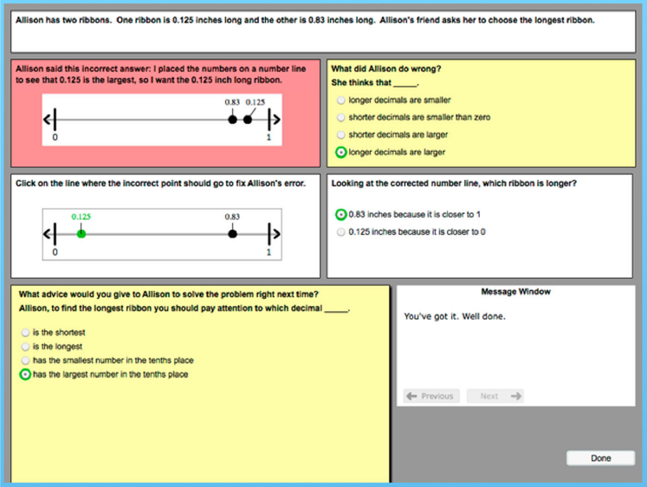
Example of Intelligent Tutoring Systems
Mathematics
Learning from Errors
Isotani et al. (2011)

Slide 18
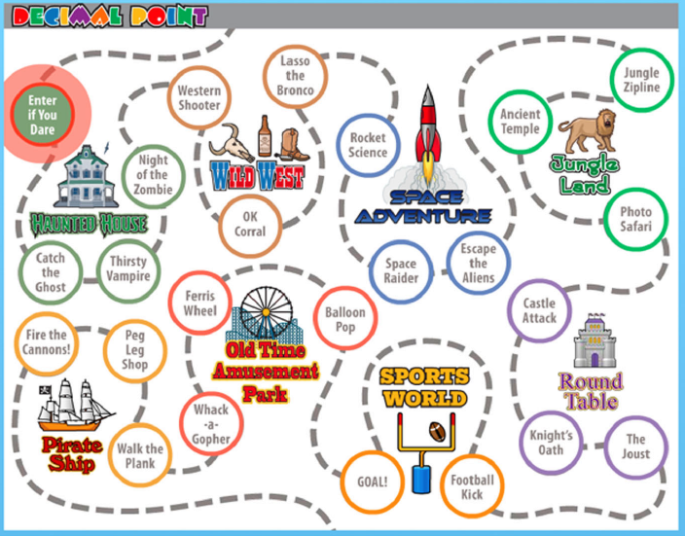
Example of Intelligent Tutoring Systems
Mathematics
Game-based learning
Aleven et al. (2016)

Slide 19
Example of Intelligent Tutoring Systems
Mathematics - Virtual reality
https://youtu.be/Dexjdmfv2c4?t=53
Holstein, K., Hong, G., Tegene, M., McLaren, B. M., & Aleven, V. (2018). The Classroom as a Dashboard: Co-designing wearable cognitive augmentation for K-12 teachers. In Proceedings of the Eighth International Learning Analytics & Knowledge Conference (pp. 79-88). ACM.

Slide 20
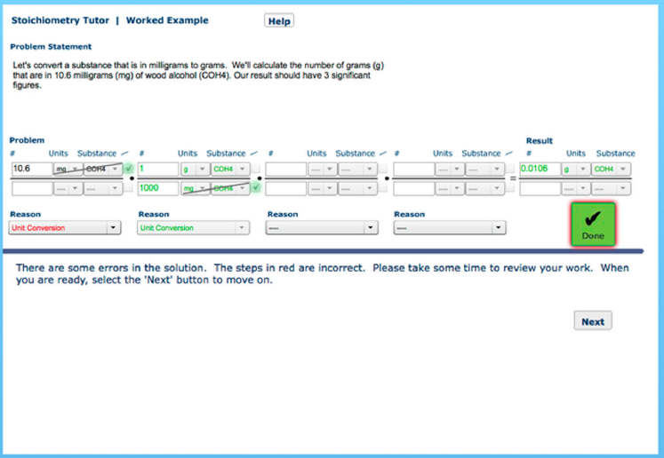
Example of Intelligent Tutoring Systems
Chemistry
Stoichiometry
Mclaren & Isotani. (2011)

Slide 21
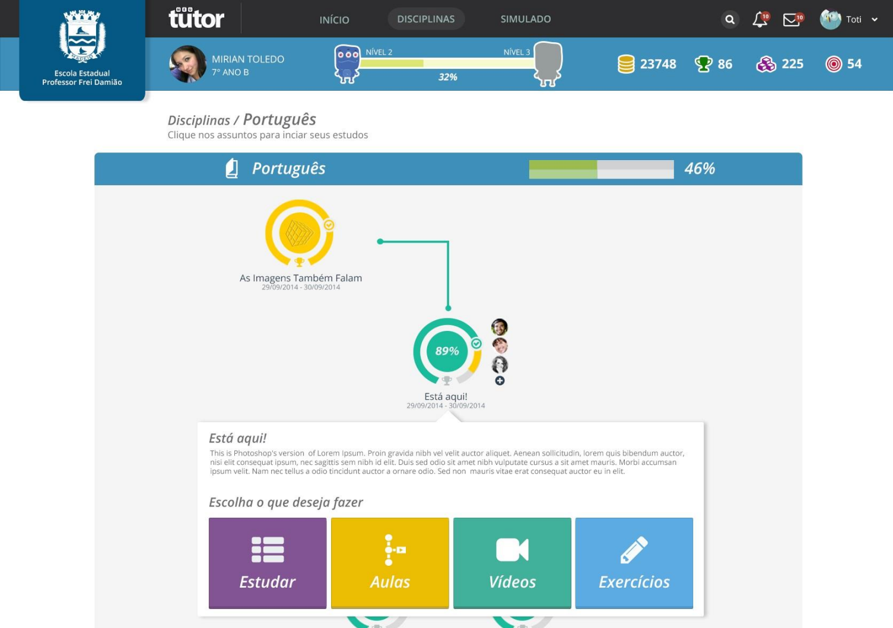
Example of Intelligent Tutoring Systems
Generic
Gamification-based ITS
Tenorio, Bittencourt, Isotani et al. (2016)

Slide 22
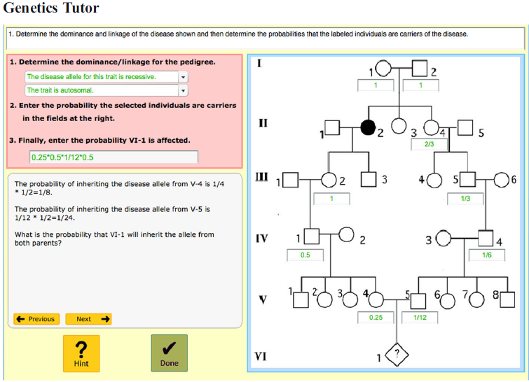
Example of Intelligent Tutoring Systems
Genetics
Aleven et al. (2016)

Slide 23
Example of Intelligent Tutoring Systems
Computer Science
Aleven et al. (2016)

Slide 24
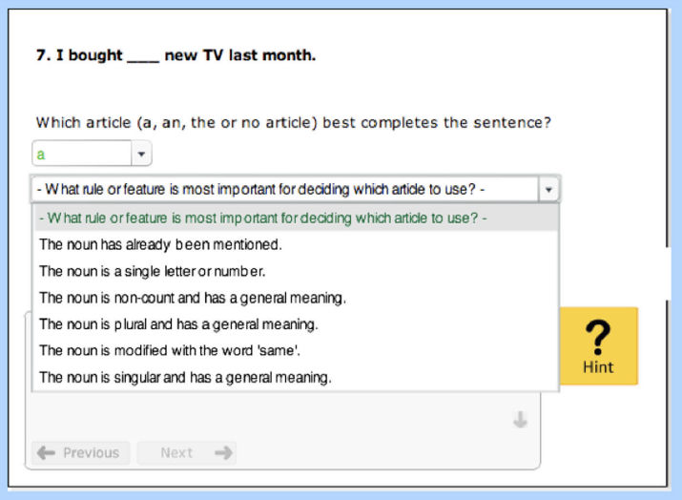
Example of Intelligent Tutoring Systems
Second Language Learning
Aleven et al. (2016)

Slide 25
Examples of Intelligent Tutoring Systems
Let’s Interact with some ITS avaiable at:
https://mathtutor.web.cmu.edu/home
Working with Decimals
Solving Equations -> Multi-Step Linear Equations
Solving Word Problems with Pictures
Area, Perimeter, Circumference
J. Sewall, V. Aleven and B. M. McLaren, (2009) "Scaling Up Programming by Demonstration for Intelligent Tutoring Systems Development: An Open-Access Web Site for Middle School Mathematics Learning," in IEEE Transactions on Learning Technologies, 2(2), pp. 64-78. http://doi.ieeecomputersociety.org/10.1109/TLT.2009.22

Slide 26
What are the most important characteristics in the observed ITS?

Slide 27
Convention problem solving
Problem statement
14
6
Koedinger & Aleven (2012)
Final Answer

Slide 28
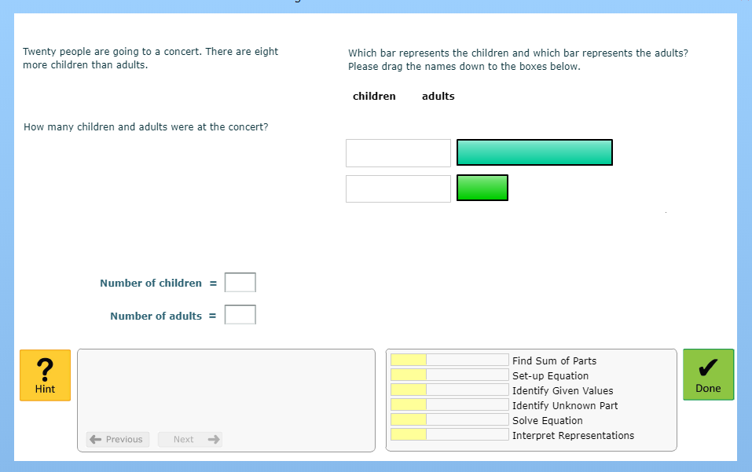
Key Characteristics of ITS

Slide 29
Key Characteristics of ITS
Problem statement

Slide 30
Key Characteristics of ITS
step
step
step
step

Slide 31
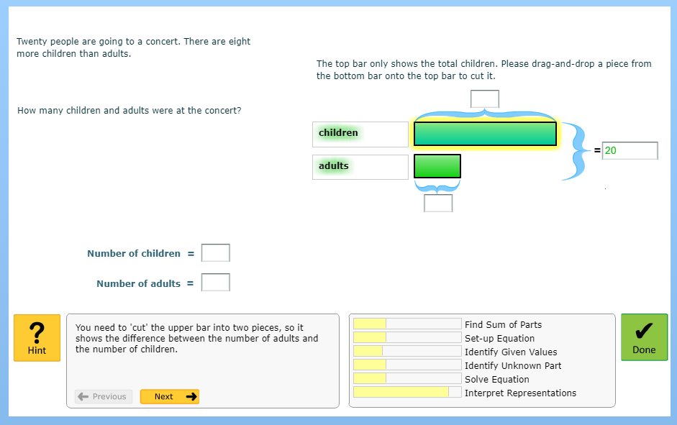
Key Characteristics of ITS
Hints
Hints

Slide 32
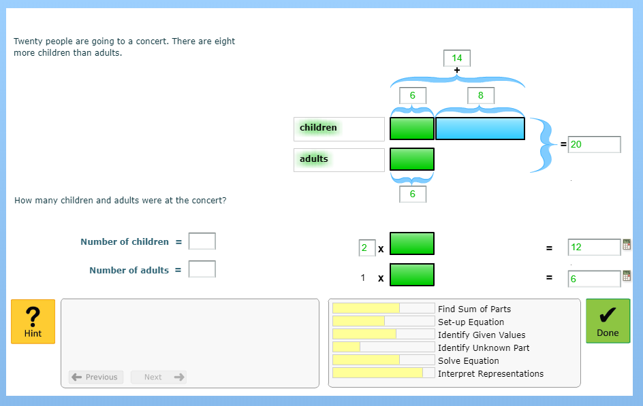
Key Characteristics of ITS
Immediate feedback to each step
scaffolding
Immediate feedback to each step

Slide 33
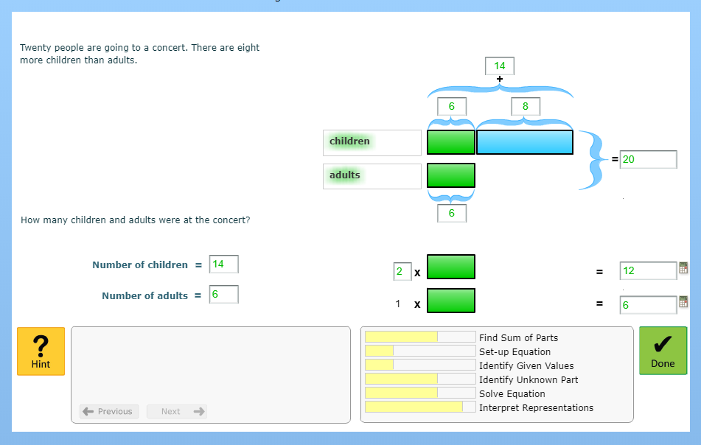
Key Characteristics of ITS
Open Learner Model

Slide 34
Key Characteristics of ITS
Final Answer

Slide 35
Key Characteristics of ITS
Step-by-step solution
Hints available in each step of the solution
Hints to the next step of the solution
Highlight of the correct/incorrect steps
Open Learner Model
These characteristics enable an ITS to provide feedbacks and opportunities for students’ self-regulation

Slide 36
Key Characteristics of ITS
BUT ....
Do feedback and self-regulation help students learn better?

Slide 37
What actions affect students the most?
(Education Endowment Foundation, 2019)

Slide 38
What actions affect students the most?
Feedback
(Education Endowment Foundation, 2019)

Slide 39
What actions affect students the most?
Meta-cognition and Self-Regulation
(Education Endowment Foundation, 2019)

Slide 40
The Importance of the Inner Loop
Step-by-step solution
Hints available in each step of the solution
Hints to the next step of the solution
Highlight of the correct/incorrect steps

Slide 41
Effectiveness of the Inner-Loop?
Evidências de melhoria na aprendizagem com STI e outras tecnologias
How to adapt What to adapt | STI design | Outer-Loop | Inner-Loop
Previous knowledge and growth | ++ | ++ | ++
Students’ strategies and errors | ++ |  | ++
Affect and motivation | ++ | ++ | ++
Self-regulation & metacognition | ++ | + | ++
Learning styles |  | --
Evidência
++ : forte
+ : fraca
-- : contrária
Aleven, V., McLaughlin, E. A., Glenn, R. A., & Koedinger, K. R. (2017). Instruction based on adaptive learning technologies. In R. E. Mayer & P. Alexander (Eds.), Handbook of research on learning and instruction (2nd ed., pp. 522-560). New York: Routledge.
http://www.cs.cmu.edu/~aleven/Papers/2016/Aleven_etal_Handbook2017_AdaptiveLearningTechnologies.pdf

Slide 42
Outer Loop versus
Inner Loop
VanLehn, K. (2006). The behavior of tutoring systems. International Journal of Artificial Intelligence in Education, 16(3), 227-265

Slide 43
Outer Loop vs. Inner Loop
ITS Actions
Previous knowledge
Learning tasks
Expected knowledge

Slide 44
Outer Loop vs. Inner Loop
ITS Actions
Previous knowledge
Inner Loop
Step-by-step support
Expected knowledge

Slide 45
Outer Loop vs. Inner Loop
ITS Actions
Previous knowledge
Inner Loop
Step-by-step support
Expected knowledge
Outer Loop Select the next task

Slide 46
Outer Loop vs. Inner Loop
Personalization
Adaptation
ITS Actions
Previous knowledge
Inner Loop
Step-by-step support
Expected knowledge
Outer Loop Select the next task

Slide 47
Características essenciais - STI
According to VanLehn (2006; 2011):
Educational technologies that have ONLY the outer loop are called Computer-Aided Instruction (CAI), and technologies that also have the inner loop are called Intelligent Tutoring Systems (ITS).

Slide 48
Inner Loop Approaches
Notes:
Semana 1: - Definição do que é um STI - 2 cases de exemplo - Exercícios - parte 1 (pensar nas aplicações práticas)
Semana 2: - Definição dos módulos de um STI - 2 cases de exemplo - Exercícios - parte 2 (pensar nas funções de cada módulo)
Semana 3: - Tutorial de como usar o CTAT - 1 Case prático com o CTAT (utilizar a ferramenta e decompor seus elementos e utilidade. Propor melhorias de acordo com contexto). - https://github.com/CMUCTAT/CTAT/wiki/Creating-a-Cognitive-Tutor
- Iniciar a construção de um STI no CTAT (propor problema para que se encontre a solução).
Semana 4: - Acompanhamento da Construção de um STI utilizando-se do CTAT para avaliação final do tópico.

Slide 49
Inner Loop
There are several approaches to adequately operationalize the inner loop so it can provide step-by-step guidance to students. We will presente 5 of them:
Minimum feedback (correct/incorrect) in each step
Specific feedback to each step
Hints to perform the next step
Assessment of student’s knowledge
Review of students’ solution (worked example)

Slide 50
Inner Loop
There are several approaches to adequately operationalize the inner loop so it can provide step-by-step guidance to students. We will presente 5 of them:
Minimum feedback (correct/incorrect) in each step
Specific feedback to each step
Hints to perform the next step
Assessment of student’s knowledge
Review of students’ solution (worked example)

Slide 51
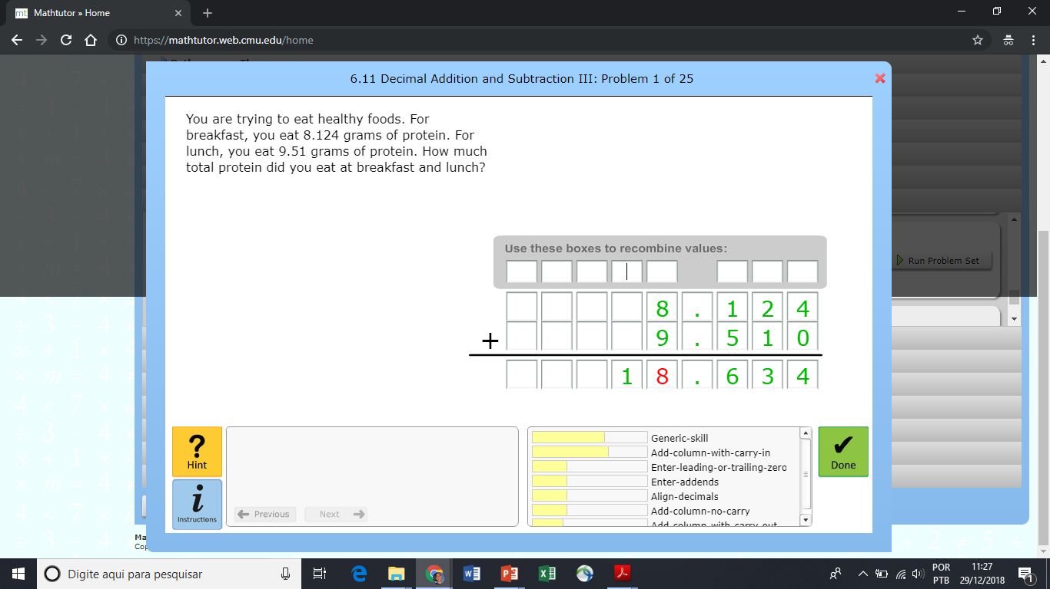
Inner Loop – Minimum Feedback
Example:
Feedback provided immediately after an action
In the example when a student have completed a step the color changes to green or red.

Slide 52
Inner Loop
There are several approaches to adequately operationalize the inner loop so it can provide step-by-step guidance to students. We will presente 5 of them:
Minimum feedback (correct/incorrect) in each step
Specific feedback to each step
Hints to perform the next step
Assessment of student’s knowledge
Review of students’ solution (worked example)

Slide 53
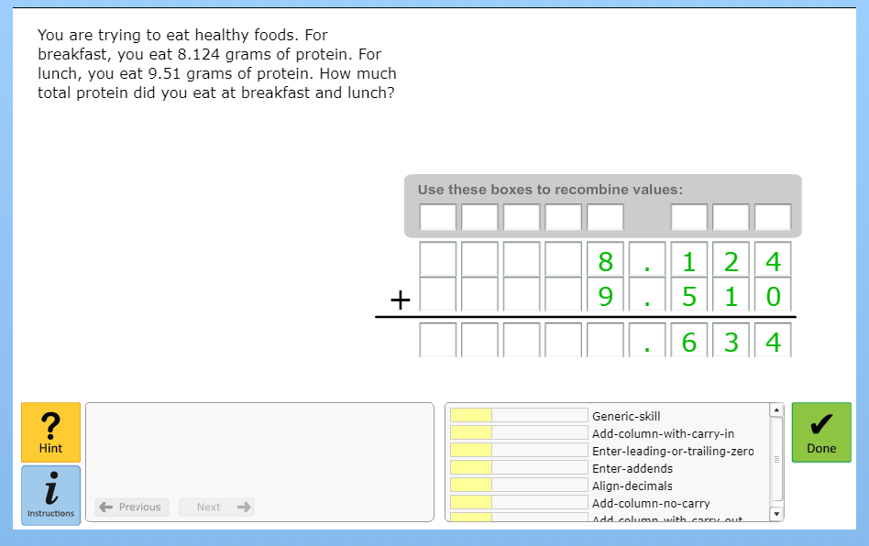
Inner Loop – Specific Feedback
Exemple:
Working with Decimals -> Decimal Addition and Subtraction III

Slide 54
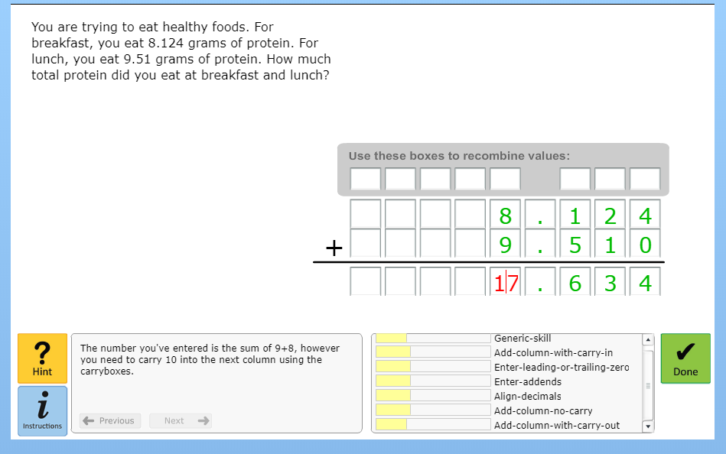
Inner Loop – Specific Feedback
1. Specific hint to a common error.

Slide 55
Inner Loop – Specific Feedback
2. On demand specific hints to complete a step:
Hints can be procedural or conceptual. In this example, we have a procedural hint.

Slide 56
Inner Loop – Specific Feedback
On demand specific hints to complete a step:
If students require more assistant, the hints become more specific.

Slide 57
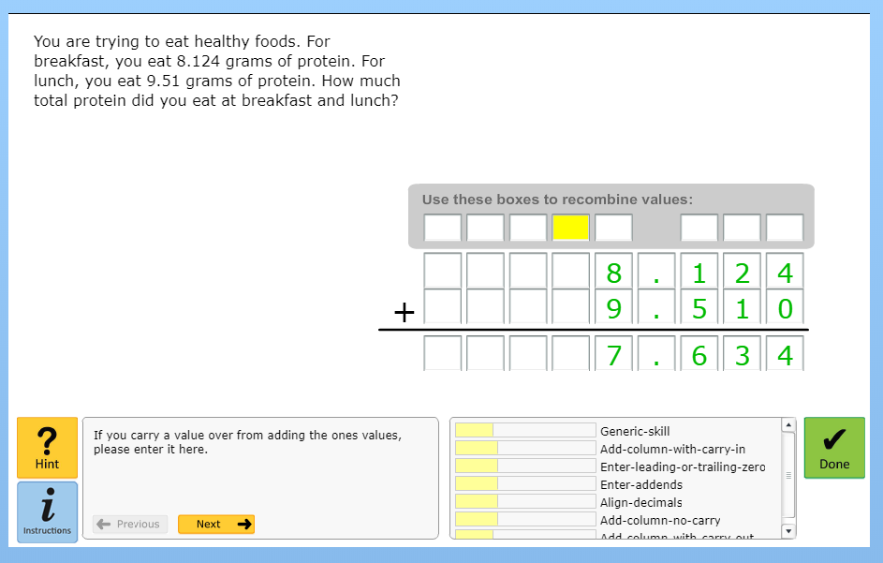
Inner Loop – Specific Feedback
On demand specific hints to complete a step:
Hints usually request students to think about what should be done to complete the step.

Slide 58
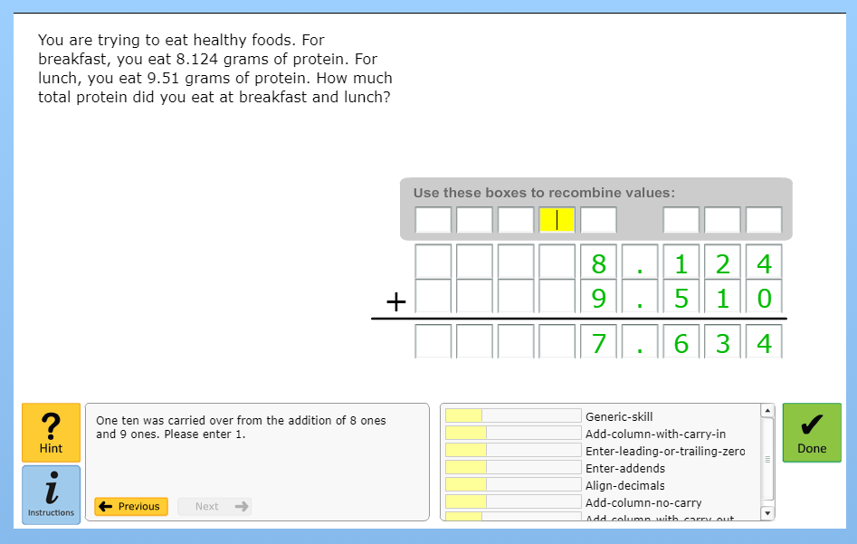
Inner Loop – Specific Feedback
On demand specific hints to complete a step:
Hints also consider the previous completed steps.

Slide 59
Inner Loop – Specific Feedback
On demand specific hints to complete a step:
Hints become more specific after each request until reaching a point where the ITS presents exactly what should be the input.

Slide 60
Inner Loop – Specific Feedback
On demand specific hints to complete a step:
In the end, students can visualize and revise the whole process to reach the solution (known as worked-example¹)
[1] https://doi.org/10.1007/978-3-642-21869-9_30

Slide 61
Inner Loop
There are several approaches to adequately operationalize the inner loop so it can provide step-by-step guidance to students. We will presente 5 of them:
Minimum feedback (correct/incorrect) in each step
Specific feedback to each step
Hints to perform the next step
Assessment of student’s knowledge
Review of students’ solution (worked example)

Slide 62
Inner Loop
Example:
Highlight the best next step to be executed.

Slide 63
Inner Loop
There are several approaches to adequately operationalize the inner loop so it can provide step-by-step guidance to students. We will presente 5 of them:
Minimum feedback (correct/incorrect) in each step
Specific feedback to each step
Hints to perform the next step
Assessment of student’s knowledge
Review of students’ solution (worked example)

Slide 64
Inner Loop - Assessment of student’s knowledge
WHAT to assess?
WHAT

Slide 65
Inner Loop - Assessment of student’s knowledge
WHAT to assess?
HOW to assess?
WHAT
HOW

Slide 66
Inner Loop - Assessment of student’s knowledge
Knowledge tracing: Modeling the acquisition of procedural knowledge (1994) https://doi.org/10.1007/BF01099821
Bayesian knowledge tracing, logistic models, and beyond: an overview of learner modeling techniques https://doi.org/10.1007/s11257-017-9193-2

Slide 67
Inner Loop
There are several approaches to adequately operationalize the inner loop so it can provide step-by-step guidance to students. We will presente 5 of them:
Minimum feedback (correct/incorrect) in each step
Specific feedback to each step
Hints to perform the next step
Assessment of student’s knowledge
Review of students’ solution (worked example)

Slide 68
Inner Loop - Review of students’ solution
Example:
Solving Equations -> Solving Multi-Step Linear Equations containing Variables and Constants on both sides

Slide 69
Inner Loop - Review of students’ solution
Example:
Ask students to think about each problem step

Slide 70
Inner Loop - Review of students’ solution
Example:
Ask students to think about each problem step

Slide 71
Inner Loop - Review of students’ solution
Example:
Ask students to think about each problem step

Slide 72
Inner Loop - Review of students’ solution
Example:
1. Show the list of steps
2. Show the minimum feedback
3. Give opportunities to think about each step

Slide 73
Inner Loop - Review of students’ solution
Example:
1. Show the list of steps
2. Show the minimum feedback
3. Give opportunities to think about each step

Slide 74
Inner Loop
In Summary,
The inner loop helps a student to:
1) Think about each problem step (i.e. self-regulated learning)
2) Solve each problem step (by giving hints and feedback)

Slide 75
The importance of the inner loop
Feedback and Self-Regulation
(Education Endowment Foundation, 2019)

Slide 76
Challenges to apply the inner loop in ITS
Notes:
Semana 1: - Definição do que é um STI - 2 cases de exemplo - Exercícios - parte 1 (pensar nas aplicações práticas)
Semana 2: - Definição dos módulos de um STI - 2 cases de exemplo - Exercícios - parte 2 (pensar nas funções de cada módulo)
Semana 3: - Tutorial de como usar o CTAT - 1 Case prático com o CTAT (utilizar a ferramenta e decompor seus elementos e utilidade. Propor melhorias de acordo com contexto). - https://github.com/CMUCTAT/CTAT/wiki/Creating-a-Cognitive-Tutor
- Iniciar a construção de um STI no CTAT (propor problema para que se encontre a solução).
Semana 4: - Acompanhamento da Construção de um STI utilizando-se do CTAT para avaliação final do tópico.

Slide 77
Challenges
Generate step-by-step feedback/hint is one of the most demanding, time-consuming, expensive and complex activity during the authoring of na ITS.
Each task needs to be associated with adequate knowledge components and each step with hints/feedback.
Currently, the inner loop is manually built or only with a small degree of automation.
(Aleven et al., 2006; 2009)

Slide 78
Challenges
Inner-loop, as currently implemented in most authoring tools, seems to not engage students:
Based on text
Fixed on the interface without considering the task
Is not personalized considering students’ characteristics
emotional status
students’ susceptibility to influence principles
Player types, etc

Slide 79
Challenges
How to develop an approach to “automatize” and speed up the implementation of the inner loop to any content and domain?
Human-computation
How to personalize the inner loop to better engage students during the learning process?
Gamification
Persuasion
Multimedia learning

Slide 80
Ongoing Research
Notes:
Semana 1: - Definição do que é um STI - 2 cases de exemplo - Exercícios - parte 1 (pensar nas aplicações práticas)
Semana 2: - Definição dos módulos de um STI - 2 cases de exemplo - Exercícios - parte 2 (pensar nas funções de cada módulo)
Semana 3: - Tutorial de como usar o CTAT - 1 Case prático com o CTAT (utilizar a ferramenta e decompor seus elementos e utilidade. Propor melhorias de acordo com contexto). - https://github.com/CMUCTAT/CTAT/wiki/Creating-a-Cognitive-Tutor
- Iniciar a construção de um STI no CTAT (propor problema para que se encontre a solução).
Semana 4: - Acompanhamento da Construção de um STI utilizando-se do CTAT para avaliação final do tópico.

Slide 81
Challenges
How to develop an approach to “automatize” and speed up the implementation of the inner loop to any content and domain?
Human-computation
How to personalize the inner loop to better engage students during the learning process?
Gamification
Multimedia learning

Slide 82
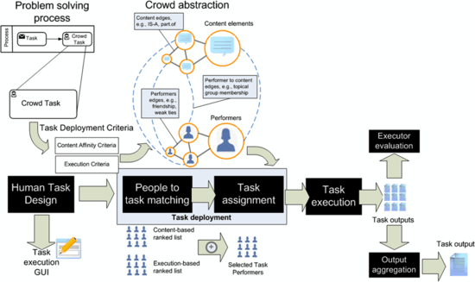
Creating the inner loop with human computation
(Ceri et al., 2012)

Slide 83
Creating the inner loop with human computation
(Ceri et al., 2012)
ITS Task
ITS Task + step-by-step solution + Hints and feedback

Slide 84
Challenges
How to develop an approach to “automatize” and speed up the implementation of the inner loop to any content and domain?
Human-computation
How to personalize the inner loop to better engage students during the learning process?
Gamification
Multimedia learning

Slide 85
Approach to personalized inner loop design
?
Non-profiled
user
Best practices & theories ^{1,2,3}
Gamiflow Framework
QPJ-BR⁴ Framework to classify player roles ⁵
Gamification profiling
1 BORGES, S. S.; DURELLI, V. H. S.; REIS, H. M.; ISOTANI, S. A systematic mapping on gamification applied to education. In: Proceedings of the 29th Annual ACM Symposium on Applied Computing - SAC ’14. New York, USA: ACM Press, 2014. P. 216–222.
2 YEE, N. Motivations for play in online games. Cyber Psychology & behavior, Mary Ann Liebert, Inc, v. 9, n. 6, p. 772–775, 2006
3 HAMARI, J.; KOIVISTO, J.; SARSA, H. Does Gamification Work? – A Literature Review of Empirical Studies on Gamification. In: 47th Hawaii Intern. Conference on System Sciences. IEEE, 2014. p. 3025–3034.
4 ANDRADE, F. R. H.; MARQUES, L. B.; BITTENCOURT, I. I.; ISOTANI, S. QPJ - BR : Questionário para Identificação de Perfis de Jogadores para o Português - Brasileiro. CBIE, p. 637–646, 2016.
5 BORGES, S. S. et al. A Link Between Worlds: Towards a Conceptual Framework for Bridging Player and Learner Roles in Gamified Collaborative Learning Contexts. In: KOCH, F. et al. (Eds.). . Advances in Social Computing and Digital Education. Cham: Springer International Publishing, 2016. v. 677p. 19–34.

Slide 86
Approach to personalized inner loop design
?
Non-profiled
user
Gamification profiling
Persuasion profiling
Best practices & theories ^{1,2,3}
Persuasion profiling techniques ^{4,5}
Br-STPS (Brazilian Portuguese Susceptibility to Persuasion Scale)⁶
1 FOGG, B. J. Persuasive Technology: Using Computers to Change What We Think and Do (Interactive Technologies). 1. ed. Morgan Kaufmann, 2002.
2 CIALDINI, R. B. Influence: The Psychology of Persuasion. HarperCollins, 1993.
3 KAPTEIN, M.; MARKOPOULOS, P.; AARTS, E. Can You Be Persuaded? Individual Differences in Susceptibility to Persuasion. In: LNCS. v. 5726, PART 1, p. 115–118, 2009.
4 KAPTEIN, M. et al. Personalizing persuasive technologies: Explicit and implicit personalization using persuasion profiles. Inter. Journal of Human Computer Studies, v. 77, p. 38–51, 2015.
5 KAPTEIN, M. et al. Adaptive Persuasive Systems. ACM Transactions on Interactive Intelligent Systems, v. 2, n. 2, p. 1–25, 1 jun. 2012.
6 BORGES, S. S.; DURELLI, V. H. S.; REIS, H. M.; BITTENCOURT, I. MIZOGUCHI, R.; ISOTANI, S. Brazilian Portuguese Cross-Cultural Adaptation and Validation of the Susceptibility to Persuasion Scale ( Br-STPS ). In: IEEE 17th International Conference on Advanced Learning Technologies. Timisoara: IEEE Computer Society, 2017. p. 1–2.

Slide 87
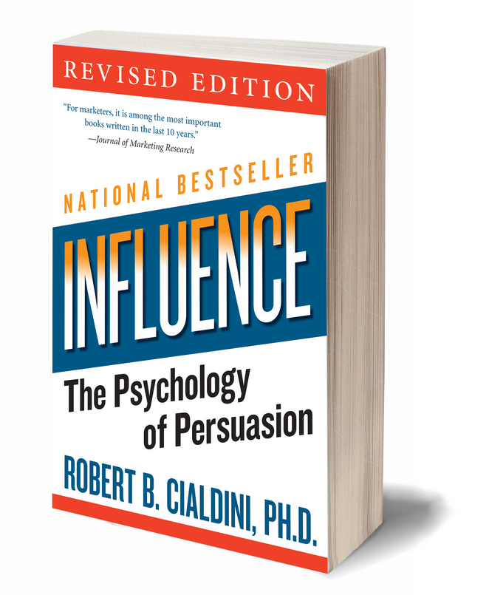
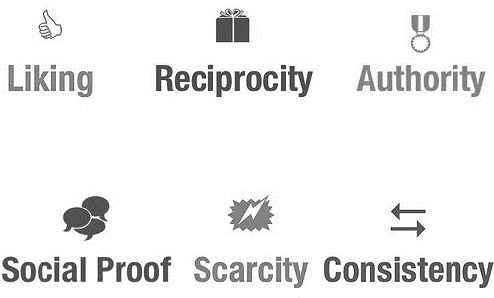
Susceptibility to Persuasion Scale¹
Influence Principles²
1 KAPTEIN, M. et al. Adaptive Persuasive Systems. ACM Transactions on Interactive Intelligent Systems, v. 2, n. 2, p. 1–25, 1 jun. 2012.
2 CIALDINI, R. B. Influence: The Psychology of Persuasion. HarperCollins, 1993.

Slide 88
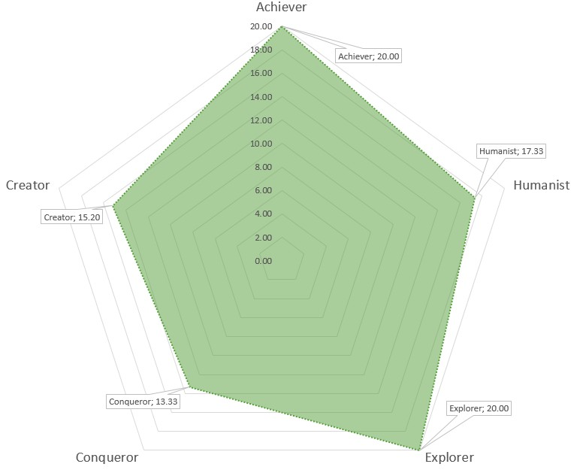
Approach to personalized inner loop design
?
Non-profiled
user
Gamification profiling
Persuasion profiling
Gamification
model
Persuasion model
Player profile

Slide 89
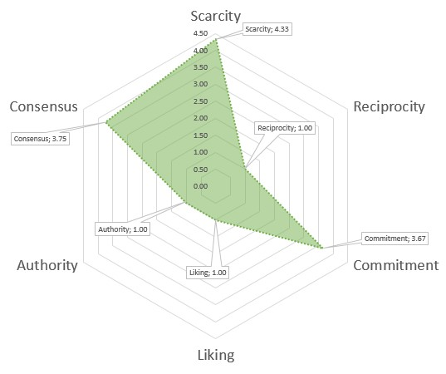
Approach to personalized inner loop design
?
Non-profiled
user
Gamification profiling
Persuasion profiling
Gamification
model
Persuasion model
Persuasion profile

Slide 90
Approach to personalized inner loop design
?
Non-profiled
user
Gamification profiling
Persuasion profiling
Gamification
model
Persuasion model
Is there a way to tailor influence principles to different player roles?
Persuasion-based gamification model

Slide 91
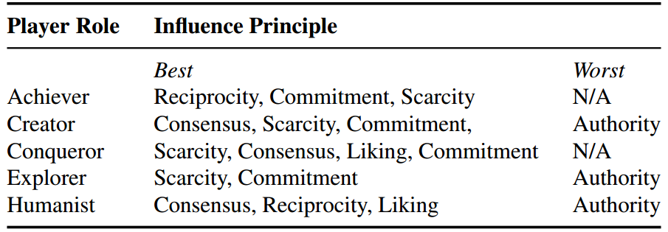
Tailoring influence principles to different player roles¹
Best and worst influence principles, from left to right, the principles are listed according to the highest path coefficient (β) measured¹.
We conduct the study at:
Universidade do Estado de Minas Gerais (N=120), and;
Instituto Federal Sul de Minas Gerais (N=32)
Instrumentation:
QPJBR²
Br-STPS³
Exploratory, confirmatory, and pathway analysis¹
1 BORGES, S. S.; DURELLI, V. H. S.; REIS, H. M.; BITTENCOURT, I. I. MIZOGUCHI, R.; ISOTANI, S. Selecting Effective Influence Principles for Tailoring Gamification-Based Strategies to Player Roles. In: XXVIII Simpósio Brasileiro de Informática na Educação. 2017. p. 234–243 (accepted for publication).
2 ANDRADE, F. R. H.; MARQUES, L. B.; BITTENCOURT, I. I.; ISOTANI, S. QPJ - BR : Questionário para Identificação de Perfis de Jogadores para o Português - Brasileiro. CBIE, p. 637–646, 2016.
3 BORGES, S. S. et al. Brazilian Portuguese Cross-Cultural Adaptation and Validation of the Susceptibility to Persuasion Scale ( Br-STPS ). IEEE 17th International Conference on Advanced Learning Technologies. Timisoara: IEEE Computer Society, 2017

Slide 92
Approach to personalized inner loop design
?
Non-profiled
user
Gamification profiling
Persuasion profiling
persuasive-based Inner loop design
Gamification
model
Persuasion model
Personalized
Inner loop design
Persuasion-based gamification model
Notes:
PbG-GUI

Slide 93
Approach to personalized inner loop design
?
Non-profiled
user
Profiled
user
Gamification profiling
Persuasion profiling
Intelligent Tutoring System
Gamification
model
Persuasion model
Personalized
inner loop design
Persuasion-based gamification model

Slide 94
THANK YOU!
Notes:
Semana 1: - Definição do que é um STI - 2 cases de exemplo - Exercícios - parte 1 (pensar nas aplicações práticas)
Semana 2: - Definição dos módulos de um STI - 2 cases de exemplo - Exercícios - parte 2 (pensar nas funções de cada módulo)
Semana 3: - Tutorial de como usar o CTAT - 1 Case prático com o CTAT (utilizar a ferramenta e decompor seus elementos e utilidade. Propor melhorias de acordo com contexto). - https://github.com/CMUCTAT/CTAT/wiki/Creating-a-Cognitive-Tutor
- Iniciar a construção de um STI no CTAT (propor problema para que se encontre a solução).
Semana 4: - Acompanhamento da Construção de um STI utilizando-se do CTAT para avaliação final do tópico.

Slide 95
Intelligent Tutoring System: The importance of the Inner Loop
Prof. Seiji Isotani
University of Sao Paulo
sisotani@icmc.usp.br

Slide 96
Approach to personalized inner loop design
?
Non-profiled
user
Profiled
user
Gamification profiling
Persuasion profiling
Intelligent Tutoring System
Gamification
model
Persuasion model
Personalized inner loop design
Persuasion-based gamification model

Slide 97
Outer Loop Approaches
Notes:
Semana 1: - Definição do que é um STI - 2 cases de exemplo - Exercícios - parte 1 (pensar nas aplicações práticas)
Semana 2: - Definição dos módulos de um STI - 2 cases de exemplo - Exercícios - parte 2 (pensar nas funções de cada módulo)
Semana 3: - Tutorial de como usar o CTAT - 1 Case prático com o CTAT (utilizar a ferramenta e decompor seus elementos e utilidade. Propor melhorias de acordo com contexto). - https://github.com/CMUCTAT/CTAT/wiki/Creating-a-Cognitive-Tutor
- Iniciar a construção de um STI no CTAT (propor problema para que se encontre a solução).
Semana 4: - Acompanhamento da Construção de um STI utilizando-se do CTAT para avaliação final do tópico.

Slide 98
Outer Loop
There are several approaches to operationalize :
Selection the task using a menu
Pre-defined sequence of tasks
Mastery learning
Macro-adaptation

Slide 99
Outer Loop
Mastery learning
Students will complete a serie of tasks (e.g. problem sets) to learn a given content until they reach a level of mastery. It requires contínuos assessment of students’ knowledge and skills as well as a great amount of tasks.
Example: For each domain content A:
Complete a set of tasks related to content A
Execute an assessment
While mastery of content A is not reached, give other tasks related to the same content.

Slide 100
Outer Loop
Similar to Mastery learning. However, the strategy to select the tasks tries to reduce the number of students’ interactions to maximaze the learning gains.
In macro adaptation the system choose the tasks that require the minimum number of knowledge components (i.e. piece of knowledge) by assessing current students’ knowledge state and the available tasks.
Each task must be associated with 1 or more knowledge components (VERY HARD AND TIME CONSUMING TASK!!!!)
Macro Adaptation

Slide 101
Outer Loop
Nota Importante 1: para que a Macro-adaptação ocorra é necessário que o Modelo do Aluno tenha pelo menos as seguintes informações:
Quais conteúdos foram utilizados
Conhecimento atual do aluno (de acordo com os CCs), incluindo erros conceituais
Conhecimento desejado para cada CCs
Informações de preferências, demografia, etc.

Slide 102
Laço Externo
Nota Importante 2: Existem dois grandes desafios para viabilizar a macro-adaptação
Identificar e associar adequadamente os CCs de cada conteúdo
Ter uma grande quantidade de conteúdo disponível (em, particular exercícios)

Slide 103
Outer Loop
There are several techniques to implement macro adaptation. Some exemples use:
Educational Data Mining (https://doi.org/10.1016/j.tele.2018.04.015)
Ontologies and Semantic Web (https://doi.org/10.1007/s10462-017-9539-5)
Genetic Algorithms (http://dx.doi.org/10.5753/cbie.sbie.2017.1137)
Recommendation System Algorithms (https://doi.org/10.1007/s10462-015-9440-z)
Agents and Multiagents (https://doi.org/10.1007/978-3-642-34654-5_64, http://www.inderscience.com/offer.php?id=48056)

