Slide 1


The challenges of designing educational systems to promote an optimal learning experience
Ig Ibert Bittencourt – ig.ibert@ic.ufal.br

Slide 2
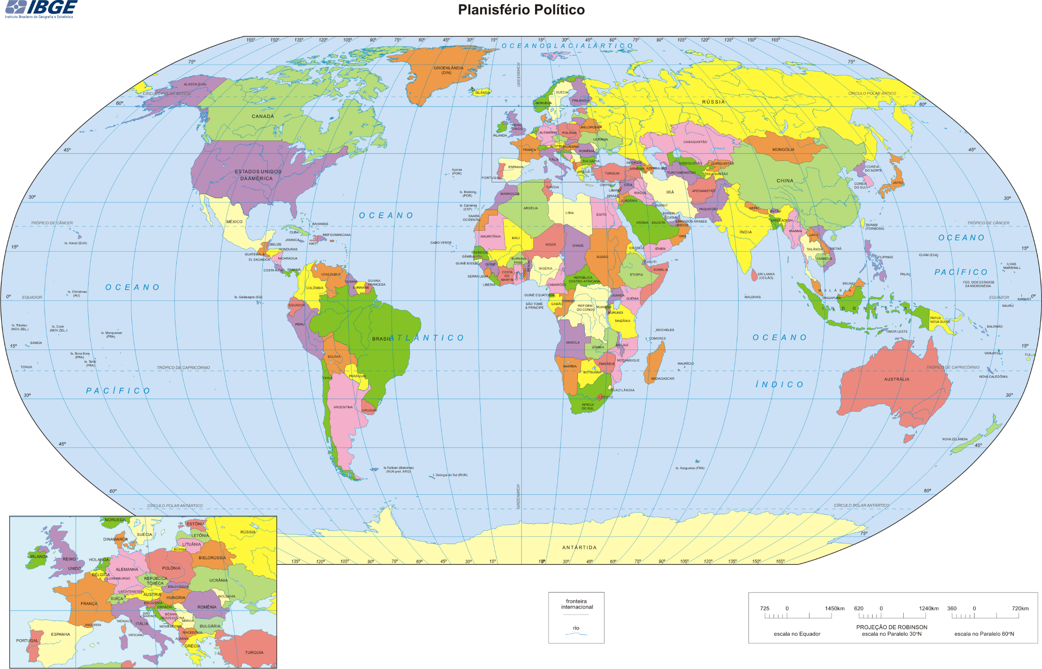
Brasil
Notes:
OK
2

Slide 3
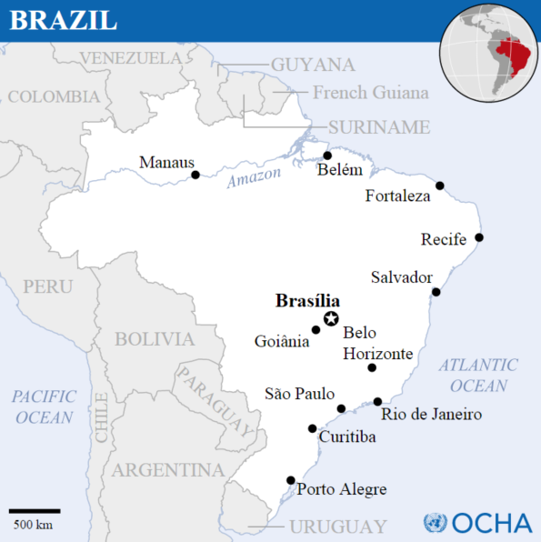
Notes:
OK
3

Slide 4
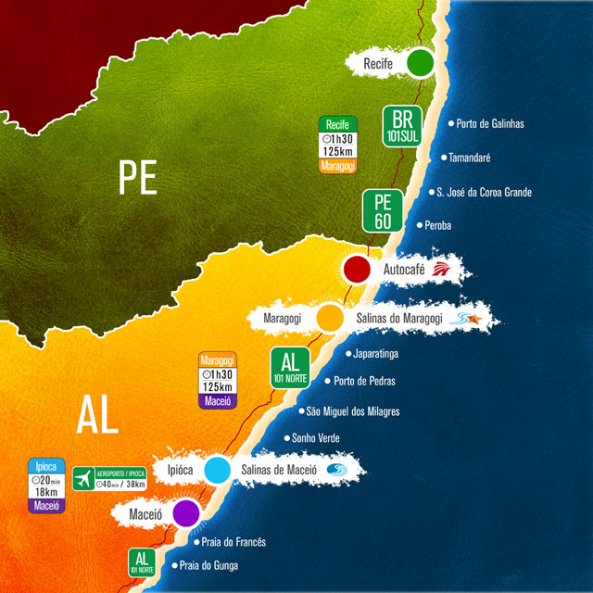
Maceió
Notes:
OK
4

Slide 5
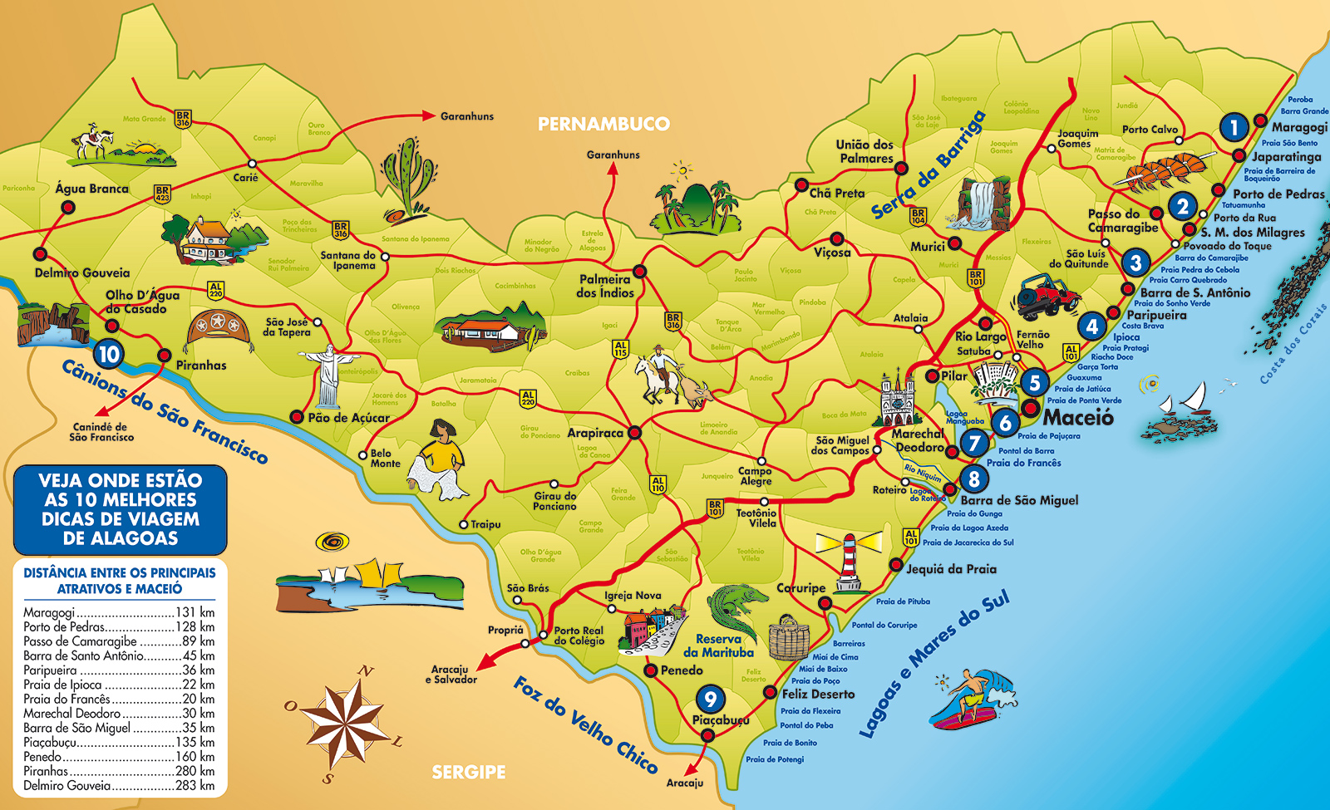
Maceió
Notes:
OK
5

Slide 6
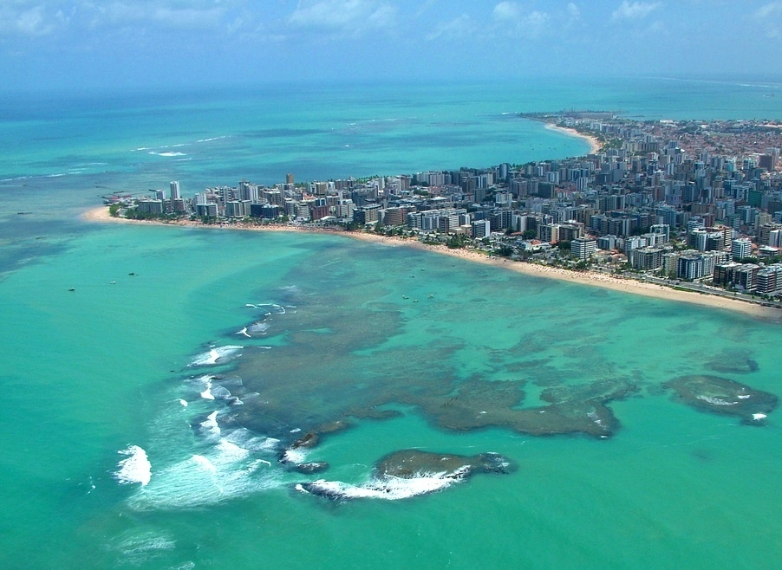
Maceió
Maceió, Alagoas, Brazil
Notes:
OK
6

Slide 7
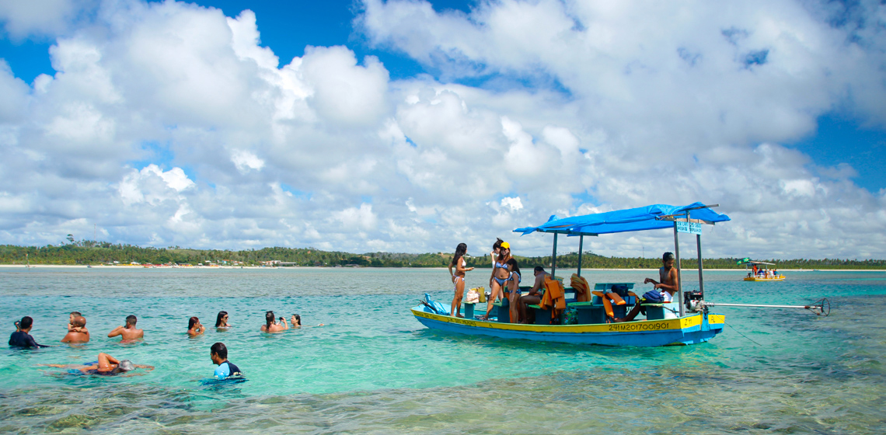
Maceió
Maceió, Alagoas, Brazil
Maceió, Alagoas, Brazil
Notes:
OK
7

Slide 8
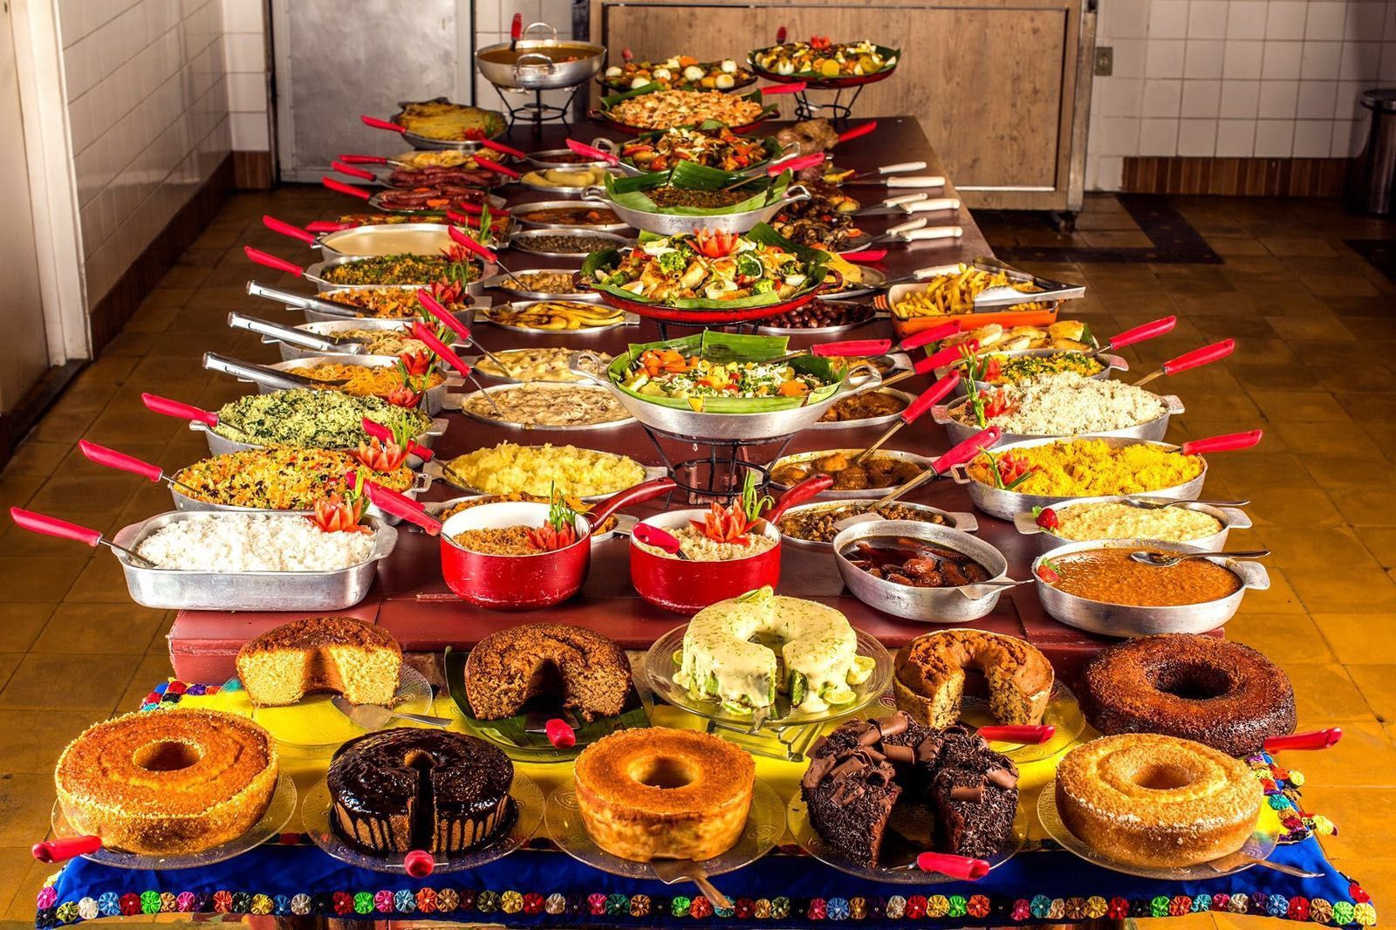
Maceió
Bodega do Sertão, Maceió, Alagoas, Brazil
Notes:
OK
8

Slide 9
The challenges of designing educational systems to promote an optimal learning experience
Ig Ibert Bittencourt – ig.ibert@ic.ufal.br

Slide 10
General Motivation
Basic Theoretical Foundations
Designing for Optimal Experience
Challenges
Research Agenda

Slide 11
General Motivation
Basic Theoretical Foundations
Designing for Optimal Experience
Challenges
Research Agenda

Slide 12
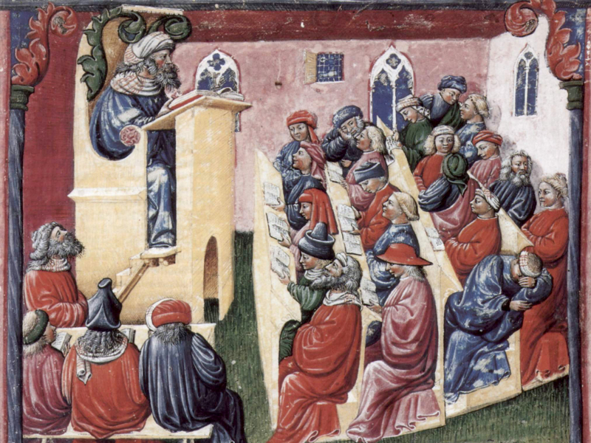
14th Century
http://media.linkjab.com/i/images/university-of-bologna-the-worlds-oldest-university.jpg
Notes:
OK

Slide 13
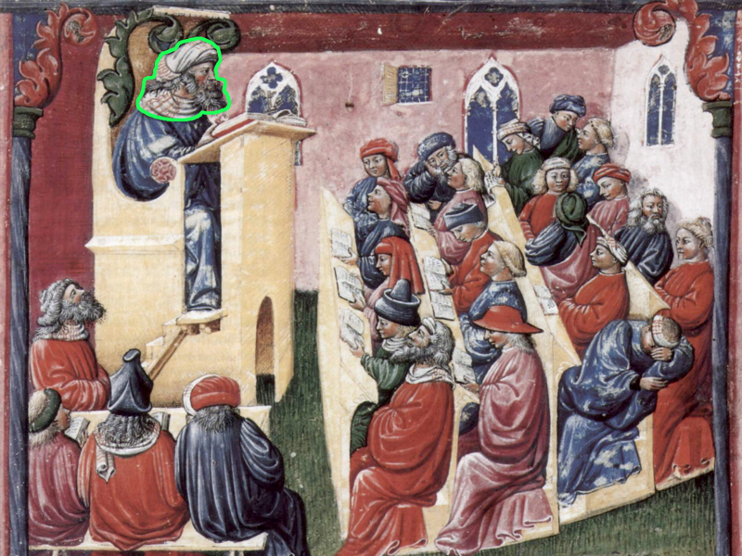
14th Century
http://media.linkjab.com/i/images/university-of-bologna-the-worlds-oldest-university.jpg
Notes:
OK

Slide 14
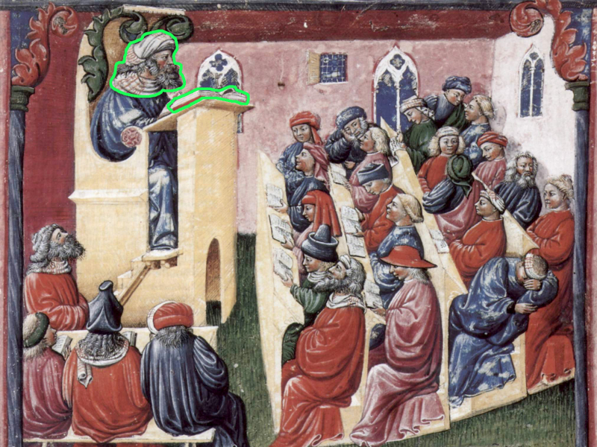
14th Century
http://media.linkjab.com/i/images/university-of-bologna-the-worlds-oldest-university.jpg
Notes:
OK

Slide 15

14th Century
http://media.linkjab.com/i/images/university-of-bologna-the-worlds-oldest-university.jpg
Notes:
OK

Slide 16
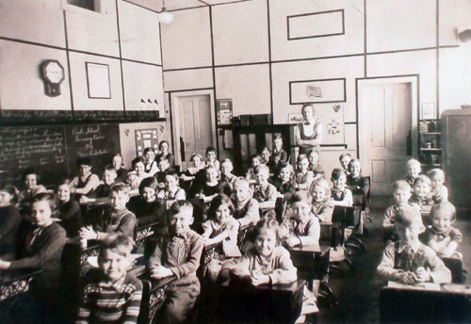
Few evolution in this area
1870 Paoli Classroom
Notes:
OK

Slide 17
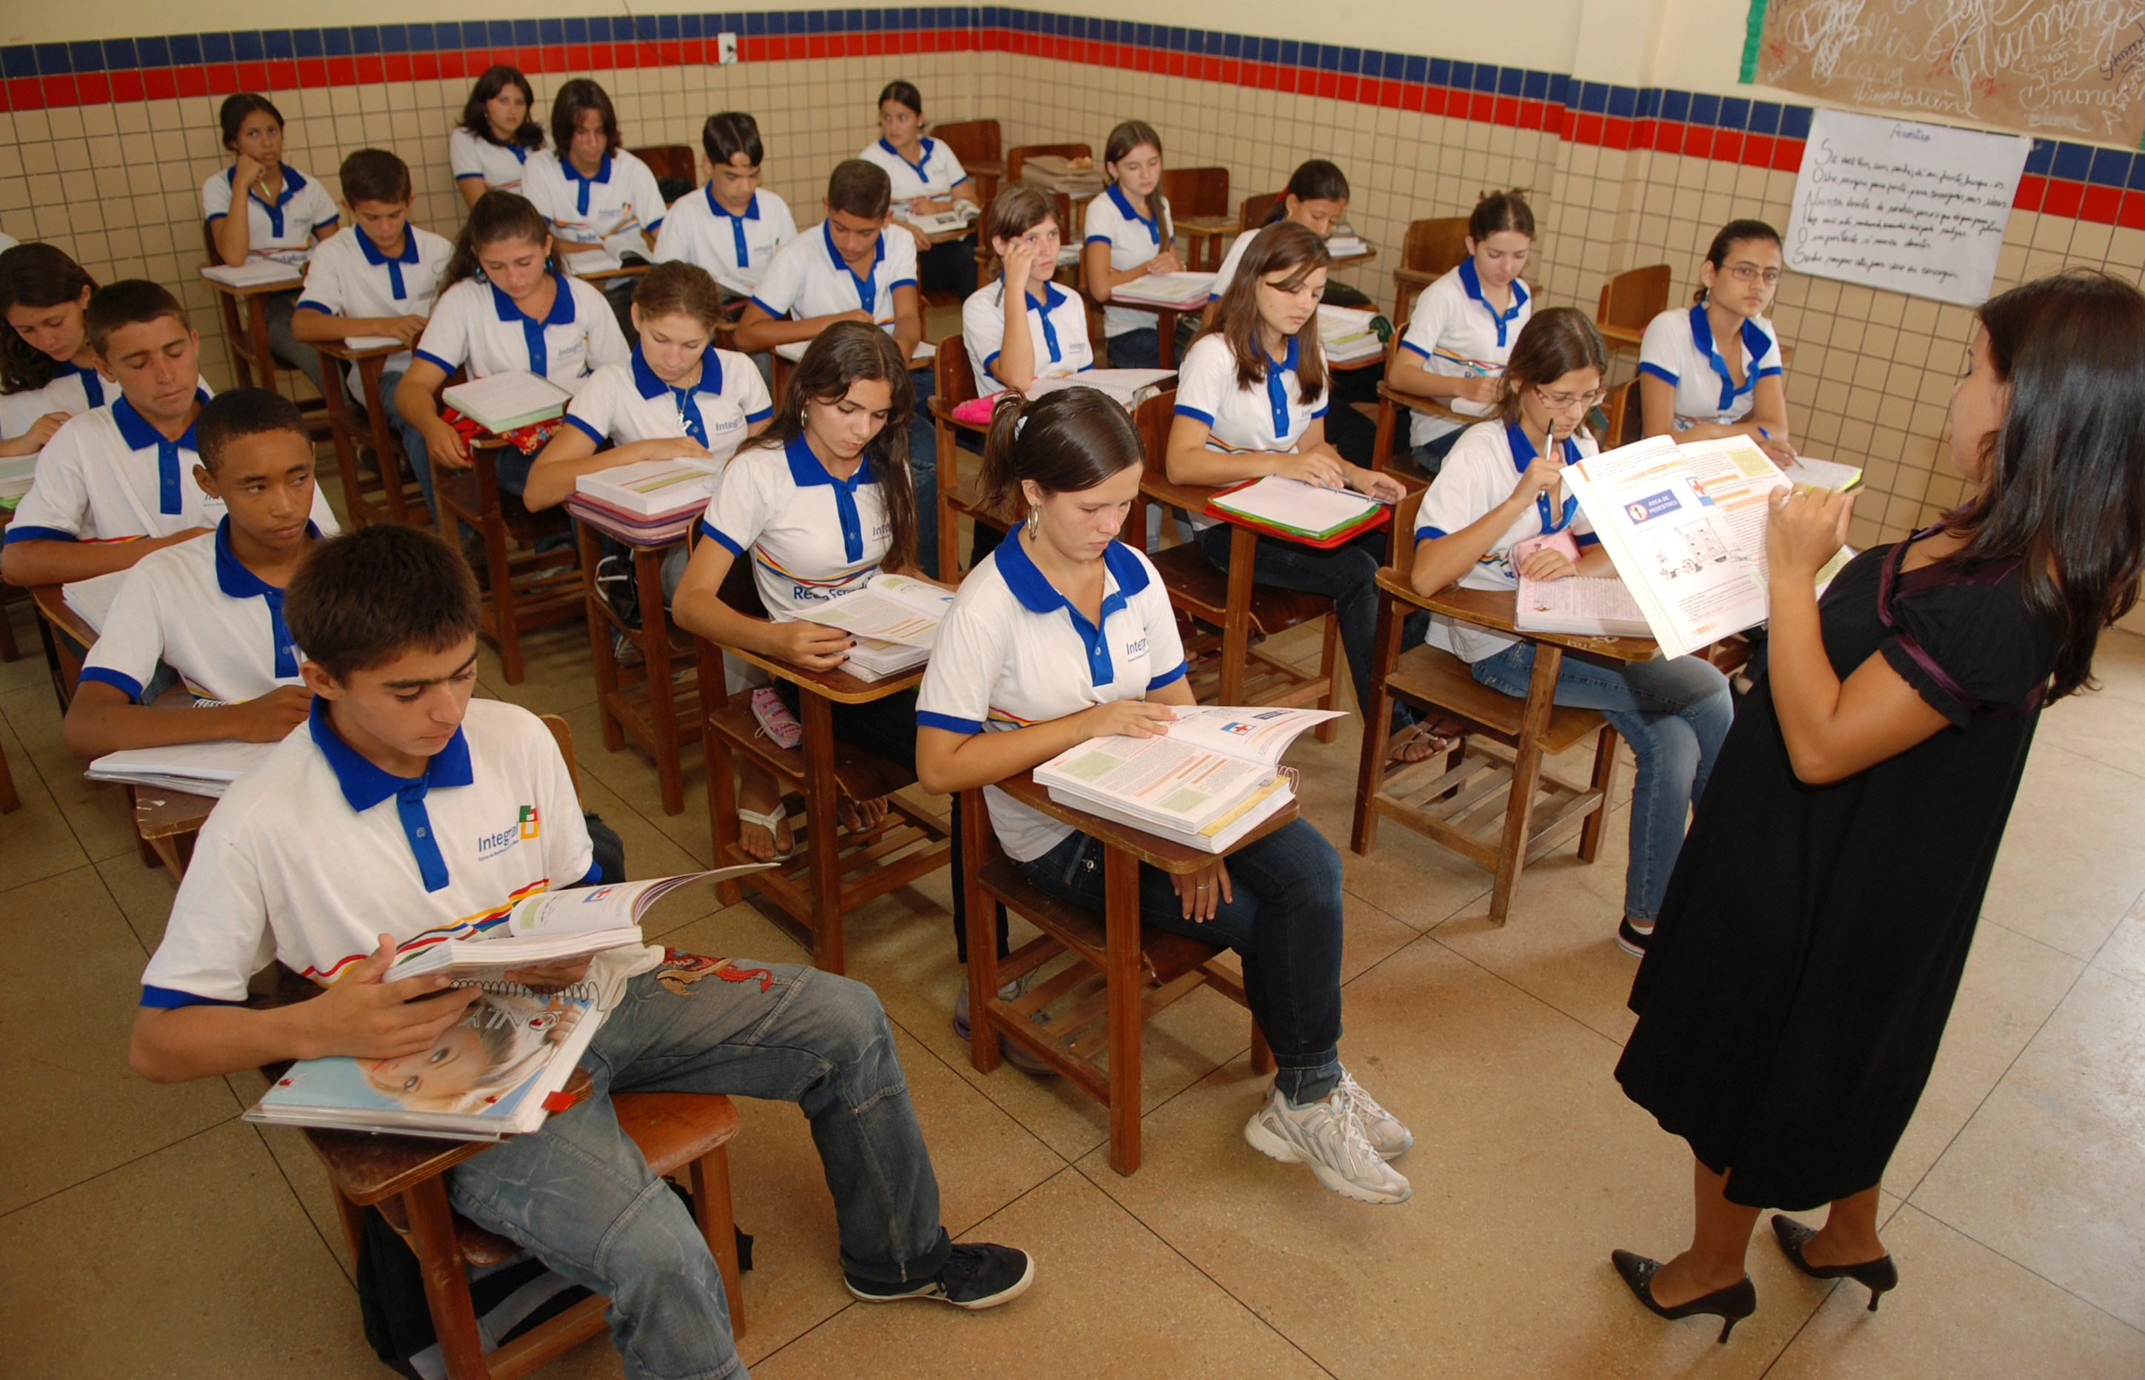
http://sjvnoticias.com/sala-de-aula-ontem-e-hoje/
2015
Notes:
OK

Slide 18
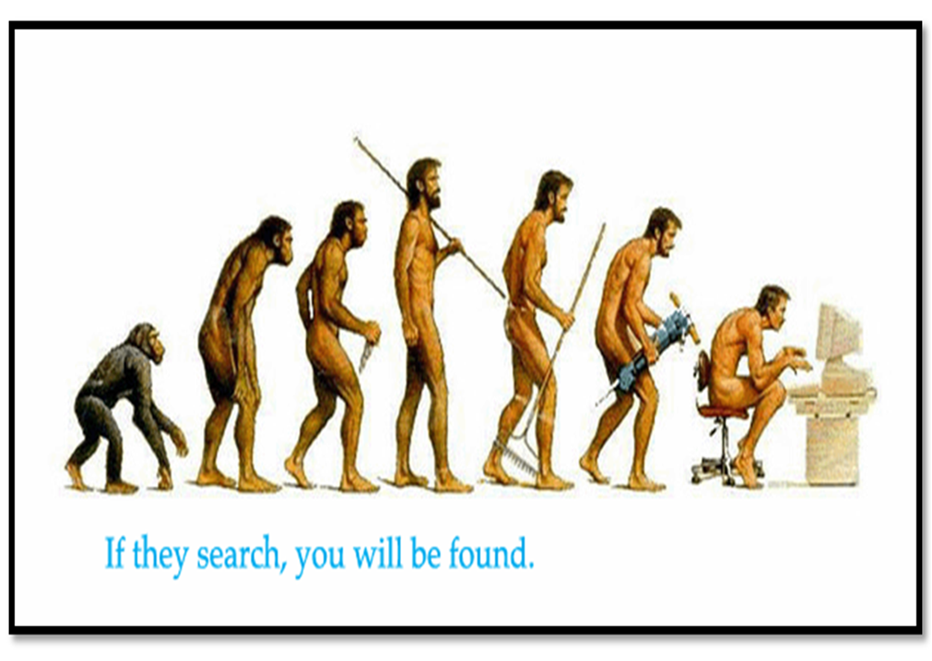
21st Century
http://www.grmwebsite.com/blog/bid/67340/Welcome-to-the-21st-Century-Why-YOU-Should-Be-Marketing-on-the-Web
Notes:
OK

Slide 19

https://onlineacademiccommunity.uvic.ca/jjohal93/category/blogs/
Notes:
OK

Slide 20

http://www.theaerodrome.com/forum/showthread.php?t=61895
Notes:
OK

Slide 21

Why students are usually disengaged in educational contexts ?
Gallup (2018). Gallup Student Poll: Engaged Today – Ready for Tomorrow. U.S. Overall. Fall 2018 Scorecard. 8pp

Slide 22
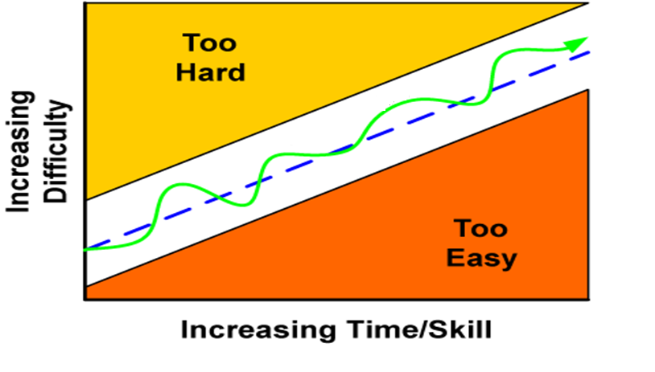
http://www.jesperjuul.net/text/fearoffailing/
Notes:
OK

Slide 23
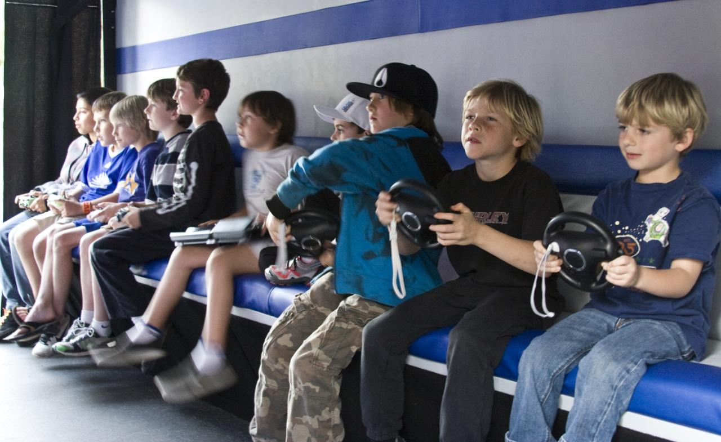
http://www.techreviewer.co.uk/english-teacher-claims-kids-playing-video-games-good/
Notes:
OK

Slide 24
General Motivation
Basic Theoretical Foundations
Designing for Optimal Experience
Challenges
Research Agenda

Slide 25
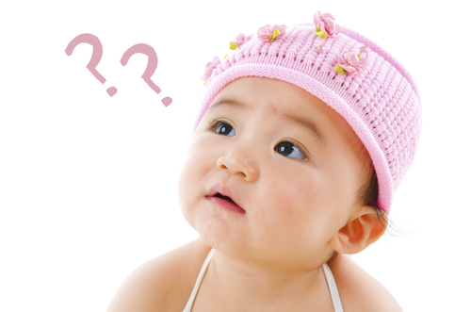
https://www.parents.com/parents-magazine/parents-perspective/what-are-our-kids-really-thinking/
Notes:
OK

Slide 26
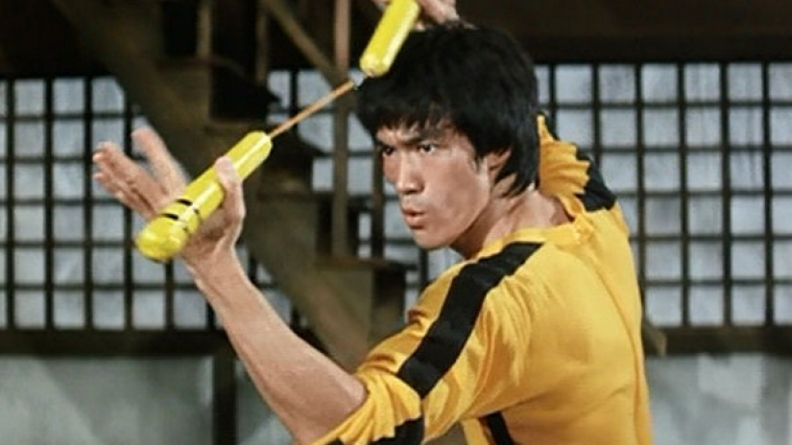
https://www.denofgeek.com/movies/bruce-lee/36045/the-top-10-brucesploitation-films
Notes:
Bruce Lee

Slide 27
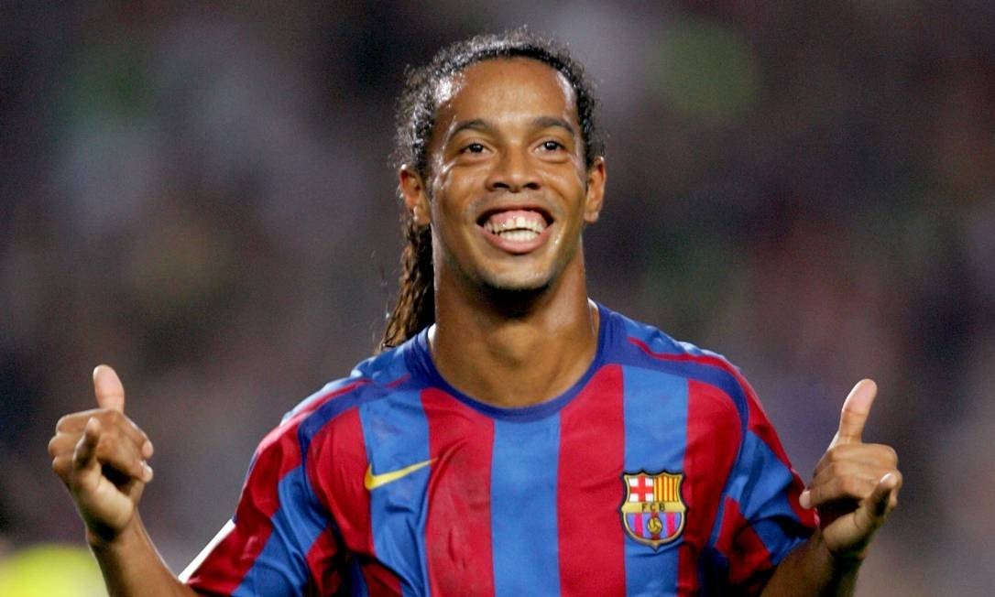
https://asianmoviepulse.com/2012/11/zhang-ziyi-woman-of-many-talents/
Notes:
Ronaldinho

Slide 28
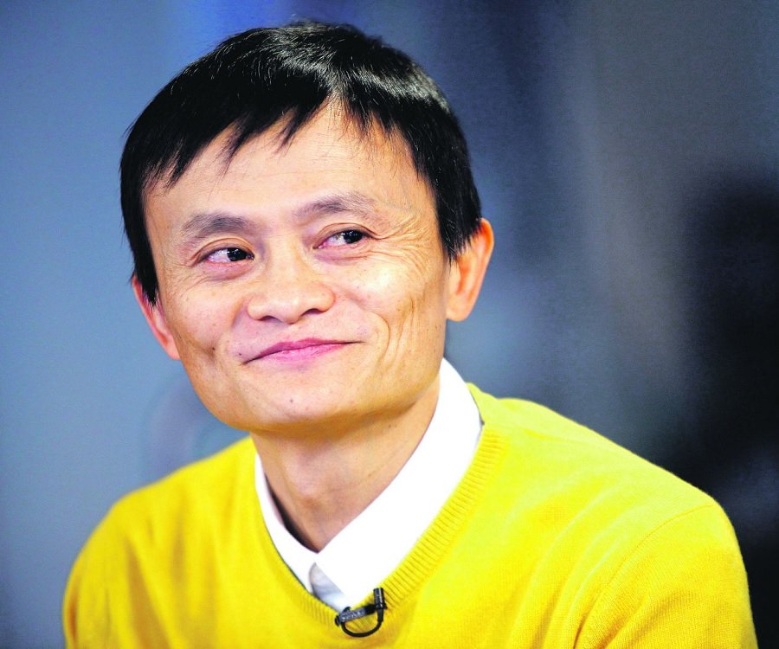
https://www.thefamouspeople.com/china.php
Notes:
Jack Ma (Alibaba)

Slide 29
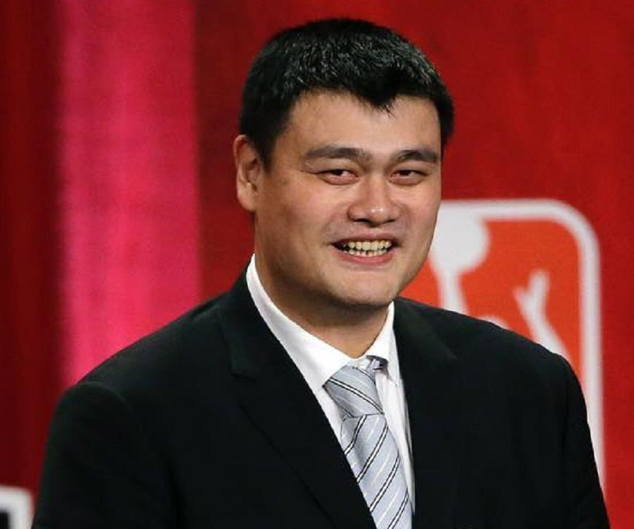
https://www.thefamouspeople.com/china.php
Notes:
Yao Ming (Chinese Basketball player)

Slide 30
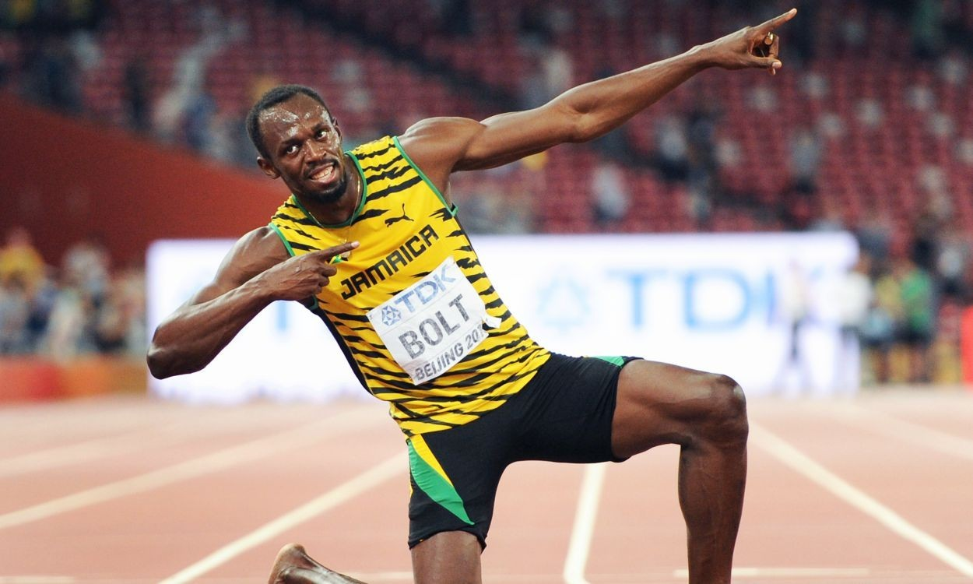
https://asianmoviepulse.com/2012/11/zhang-ziyi-woman-of-many-talents/
Notes:
U. Bolt

Slide 31
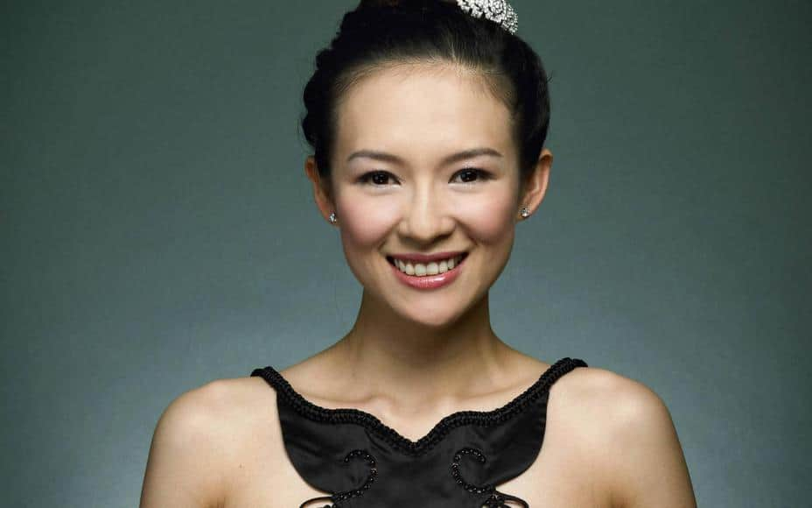
https://asianmoviepulse.com/2012/11/zhang-ziyi-woman-of-many-talents/
Notes:
Zhang Ziyi (Chinese actress)

Slide 32

https://asianmoviepulse.com/2012/11/zhang-ziyi-woman-of-many-talents/
Notes:
Zhang Ziyi (Chinese actress)

Slide 33
What those people have in common ?

Slide 34
Their Performance
(and the way they perform)

Slide 35
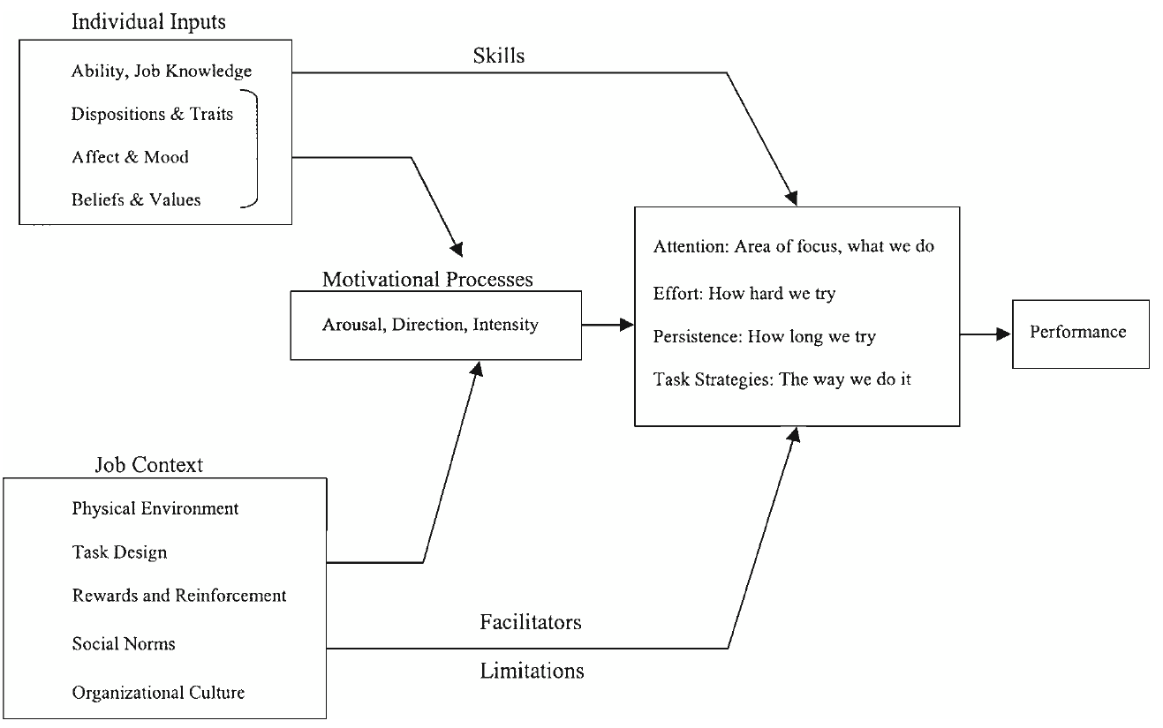
Flow Theory: The Theory of Optimal Experience

Slide 36
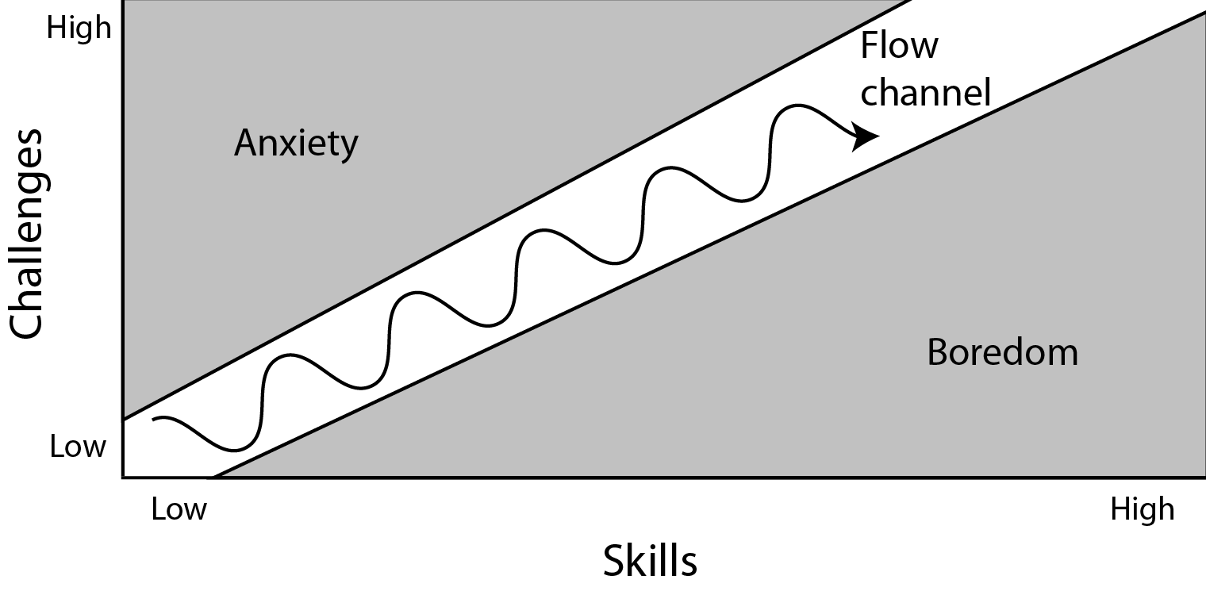

Slide 37
Flow Theory: The Theory of Optimal Experience
Flow represents those moments when everything comes together for the performer
Flow is often associated with high levels of performance and is a positive psychological experience
[1] Csikszentmihalyi M (1991) Flow: The Psychology of Optimal Experience, 1 edition. Harper, New York

Slide 38
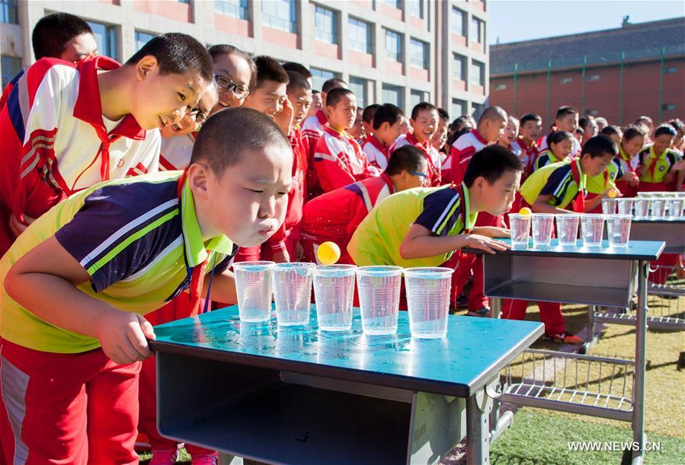
https://www.bbc.com/news/world-asia-46071811
http://www.techreviewer.co.uk/english-teacher-claims-kids-playing-video-games-good/
Notes:
OK

Slide 39
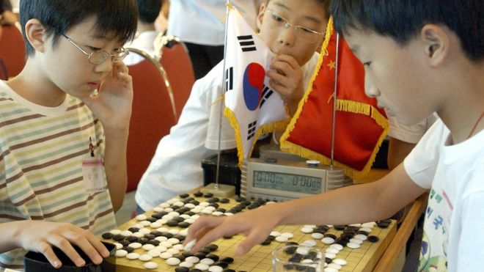
https://www.bbc.com/news/world-asia-46071811
http://www.techreviewer.co.uk/english-teacher-claims-kids-playing-video-games-good/
Notes:
OK

Slide 40
Flow Theory: The Theory of Optimal Experience
Engagement:
Initial Interest (caused
initially by curiosity)
[1] Brown E, Cairns P (2004) A Grounded Investigation of Game Immersion. In: CHI ’04 Extended Abstracts on Human Factors in Computing Systems. ACM, New York, NY, USA, pp 1297–1300.

Slide 41
Flow Theory: The Theory of Optimal Experience
Total Imersion:
Optimal Experience
(Flow Experience)
Absortion:
Continuous Interest (often caused by
challenge and fantasy)
Engagement:
Initial Interest (caused
initially by curiosity)
[1] Brown E, Cairns P (2004) A Grounded Investigation of Game Immersion. In: CHI ’04 Extended Abstracts on Human Factors in Computing Systems. ACM, New York, NY, USA, pp 1297–1300.

Slide 42



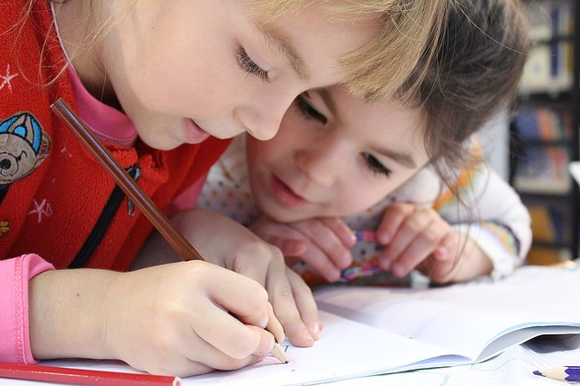




Flow Theory: The Theory of Optimal Experience
Challenge-skill
balance
(2) Clear Goals
(3) Unambiguous feedback
(4) Action-awareness
merging
(5) Total concentration
on the task at hand
(6) Sense of control
(7) Loss of self-consciousness
(8) Transformation of time
(9) Autotelic experience

Slide 43
General Motivation
Basic Theoretical Foundations
Designing for Optimal Experience
Challenges
Research Agenda

Slide 44
Flow Theory: The Theory of Optimal Experience
Challenge-skill
balance
(2) Clear Goals
(3) Unambiguous feedback
(4) Action-awareness
merging
(5) Total concentration
on the task at hand
(6) Sense of control
(7) Loss of self-consciousness
(8) Transformation of time
(9) Autotelic experience

Slide 45
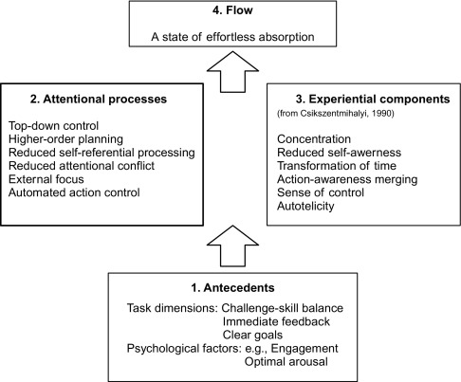
Componentes da Experiência do Fluxo
Harris, D.; Vine, S.; Wilson, M. Neurocognitive Mechanisms of Flow State. Progress in Brain Research. v. 234. p. 221-243. 2017.

Slide 46
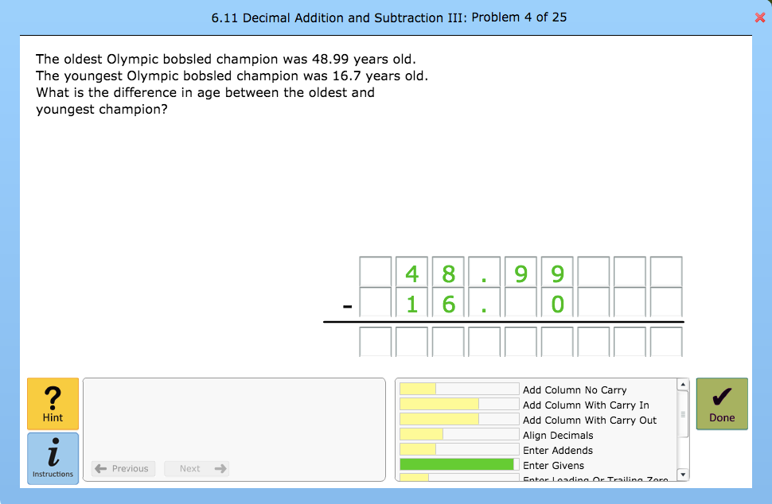
Flow Theory: Decomposing the learning process into learning scenarios and stages
Preparation
Execution
Feedback
...
You got it

Slide 47
?
?
Optimal Learning Experience
?
?

Slide 48
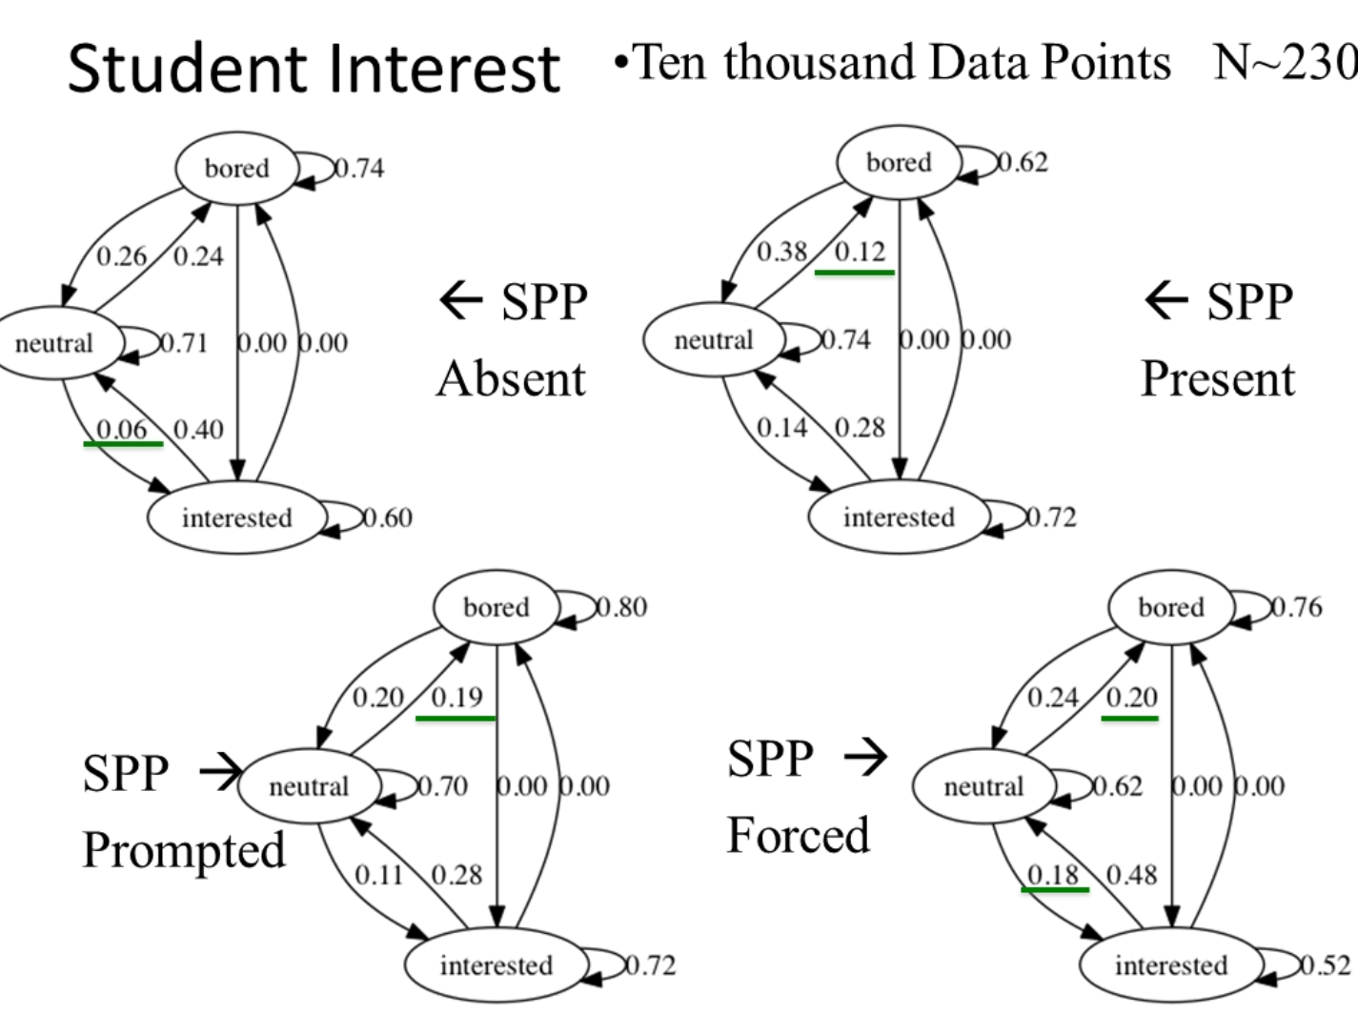
Affective, Cognitive and Metacognitive approaches

Slide 49
Gamification
Intelligent Tutoring Systems
Optimal Learning Experience

Slide 50
Gamification
Intelligent Tutoring Systems
Optimal Learning Experience

Slide 51
Componentes da Experiência do Fluxo
Harris, D.; Vine, S.; Wilson, M. Neurocognitive Mechanisms of Flow State. Progress in Brain Research. v. 234. p. 221-243. 2017.

Slide 52
Why Intelligent Tutoring Systems ?
The concept of challenge-skill balance is crucial to the definition of flow
Flow occurs only when the individual moves beyond his or her average experience of challenge and skill
When the perceived challenges are matched by a belief in having the skills to meet the challenge, the stage is set for flow to occur
[1] Csikszentmihalyi M (1991) Flow: The Psychology of Optimal Experience, 1 edition. Harper, New York

Slide 53
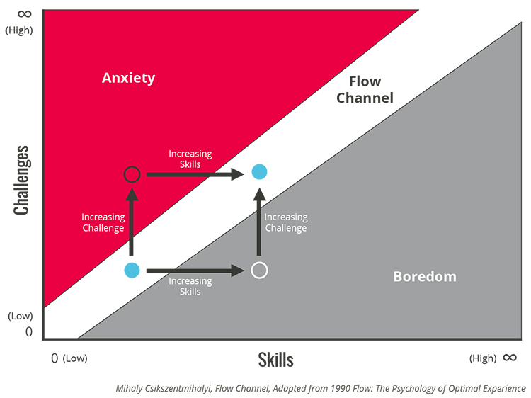

Slide 54
Course
Subjects
Skills
Notes:
OK

Slide 55
Notes:
OK

Slide 56
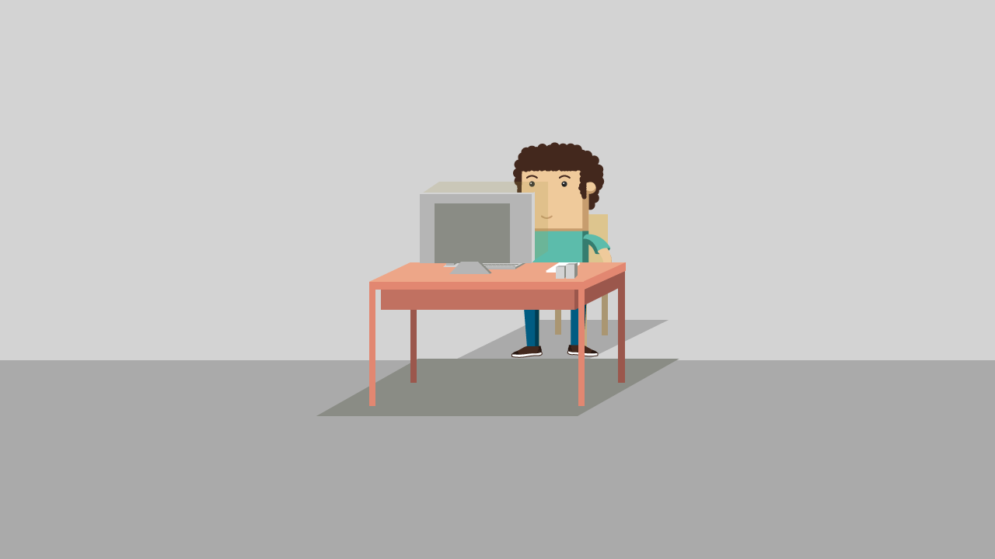




Notes:
OK

Slide 57
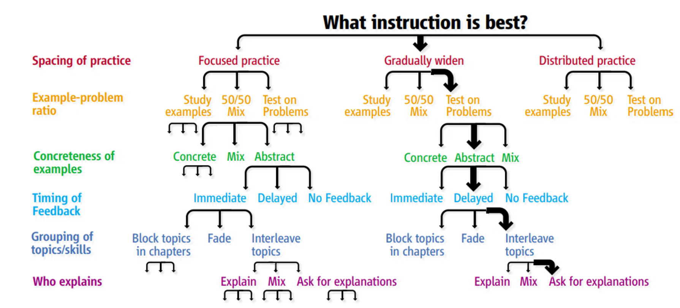

Slide 58
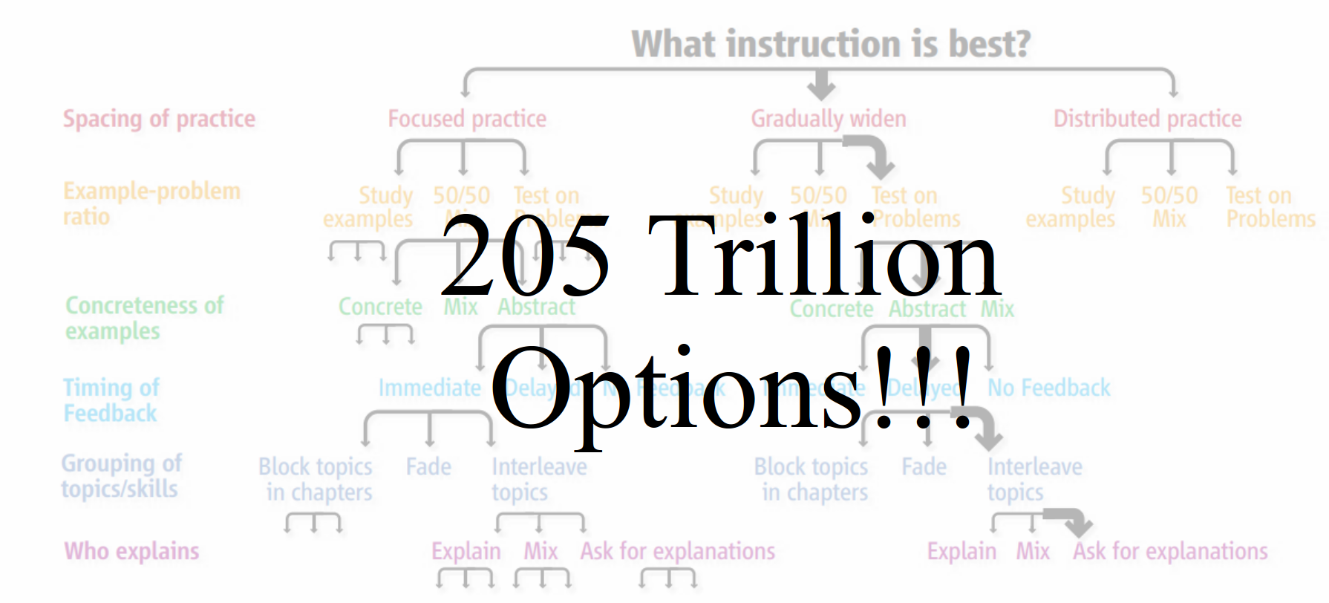

Slide 59
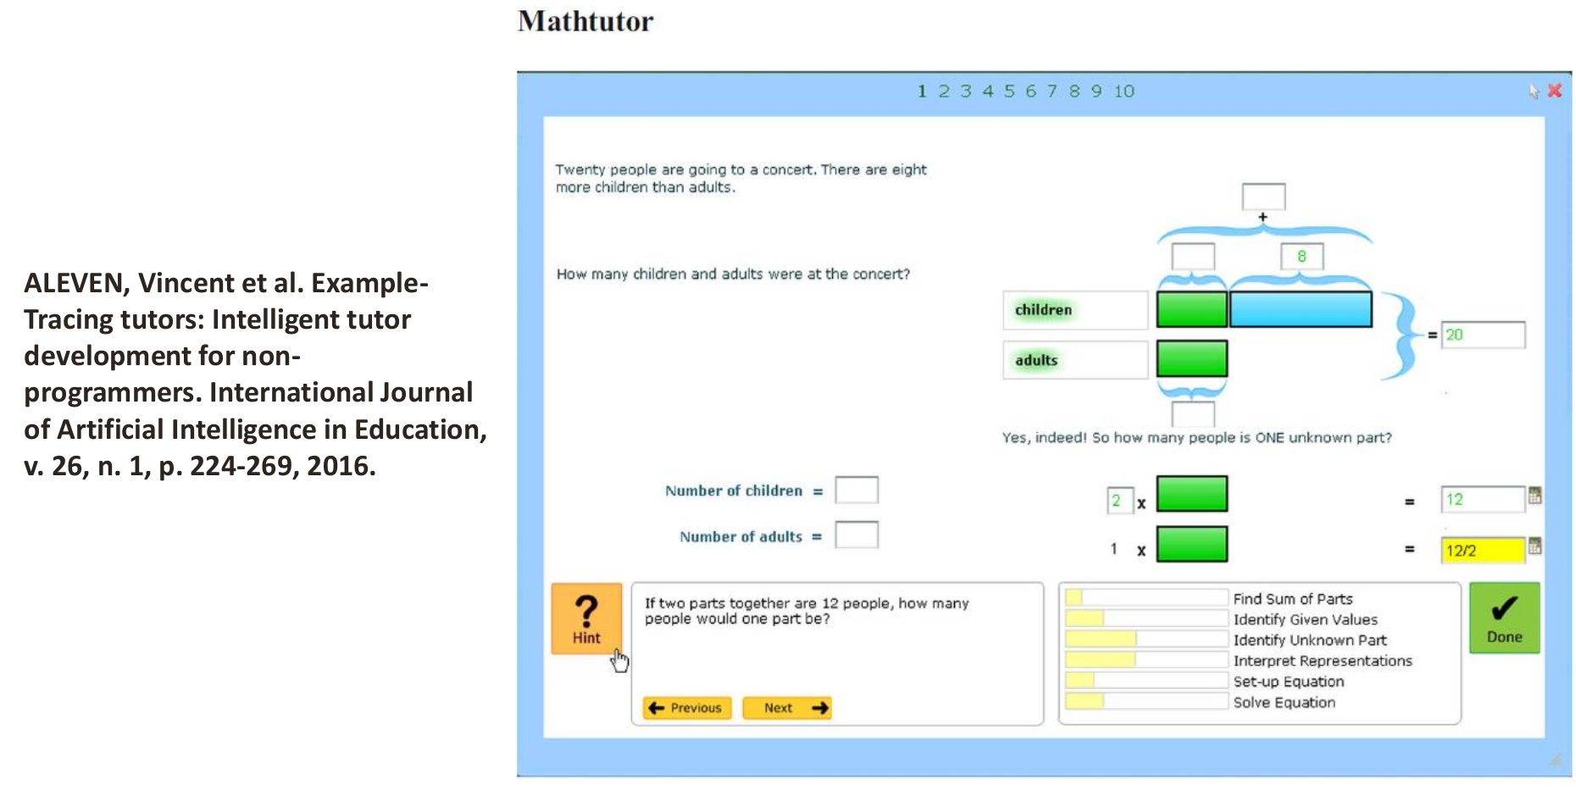

Slide 60
Gamification
Intelligent Tutoring Systems
Optimal Learning Experience

Slide 61
Gamification
Intelligent Tutoring Systems
Optimal Learning Experience

Slide 62
Why Gamification ?
Total Imersion:
Optimal Experience
(Flow Experience)
Absortion:
Continuous Interest (often caused by
challenge and fantasy)
Engagement:
Initial Interest (caused
initially by curiosity)
[1] Brown E, Cairns P (2004) A Grounded Investigation of Game Immersion. In: CHI ’04 Extended Abstracts on Human Factors in Computing Systems. ACM, New York, NY, USA, pp 1297–1300.

Slide 63
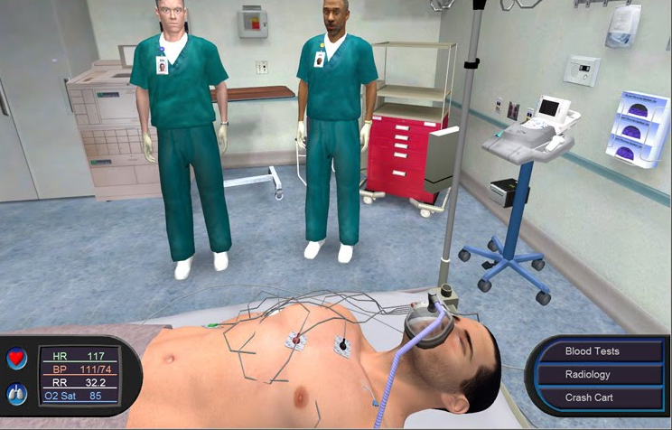
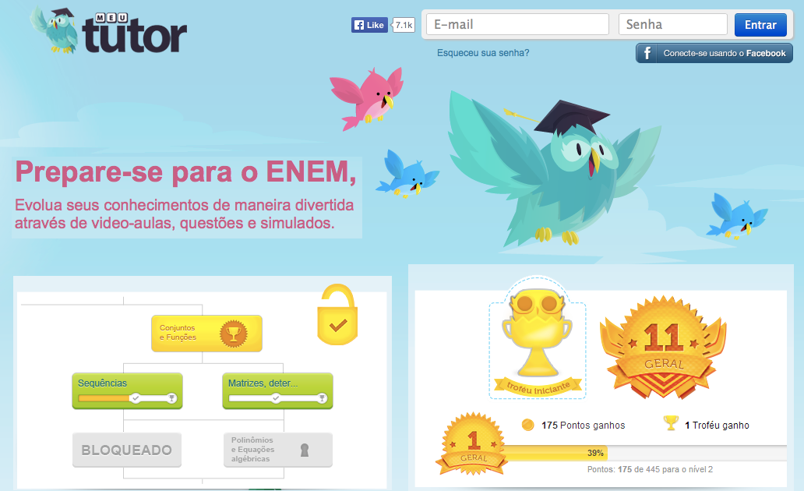
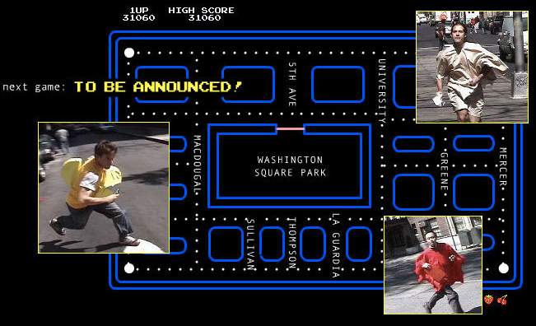
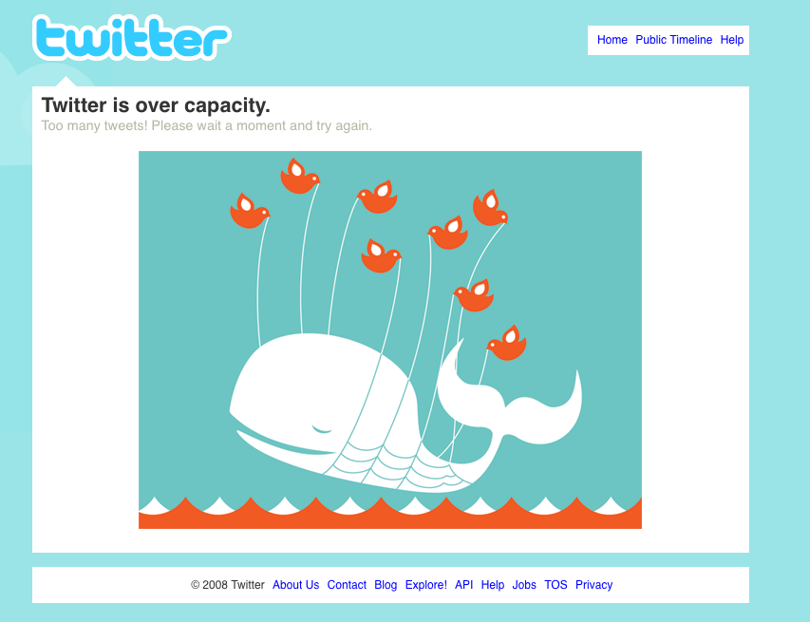
Ludus
Gamification
Serious Games
Ref. (1)
Photo (https://goo.gl/R4fAwA) by Serious-Game.fr/CC 2.0
Photo (https://goo.gl/aAHg1t ) © pacmanhattan.com
Photo (https://flic.kr/p/51xSd1) by Chris Messina/CC BY-NC-SA 2.0
Whole
Part
Ref. (2)
Ref. (3)
Play
Playful design
Paidia

Slide 64
“the use of game design elements in nongame contexts”
(Deterding, Dixon, Khaled, & Nacke, 2011)
“Gamification is not itself a product; one [a teacher] does not create a gamification as one creates a game.
Instead, one [a teacher] adds game elements to change a process that already exists to change how that process influences people”¹
¹ Gamification Science, Its History and Future: Definitions and a Research Agenda
Richard N. Landers, Elena M. Auer, Andrew B. Collmus, and Michael B. Armstrong
Simulation & Gaming (2018). tps://doi.org/10.1177/1046878118774385

Slide 65
What is Game Design Elements?
Progress
Bar
Points
Leaderboard
Notes:
And, what are these Game Design Elements?
Any signitficant element to gameplay that can be found in most games, but not necessarily on all games¹.
Exemples are: Progress bars, points and Leaderboards
[1] Deterding S, Dixon D, Khaled R, Nacke L (2011) From game design elements to gamefulness: defining gamification. In: Proceedings of the 15th International Academic MindTrek Conference: Envisioning. ACM, pp 9–15

Slide 66
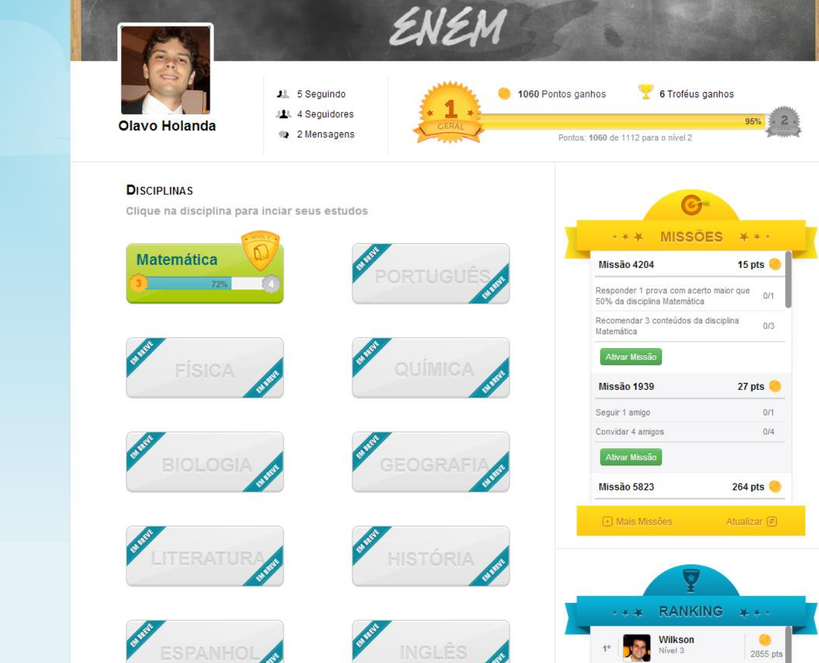

Slide 67
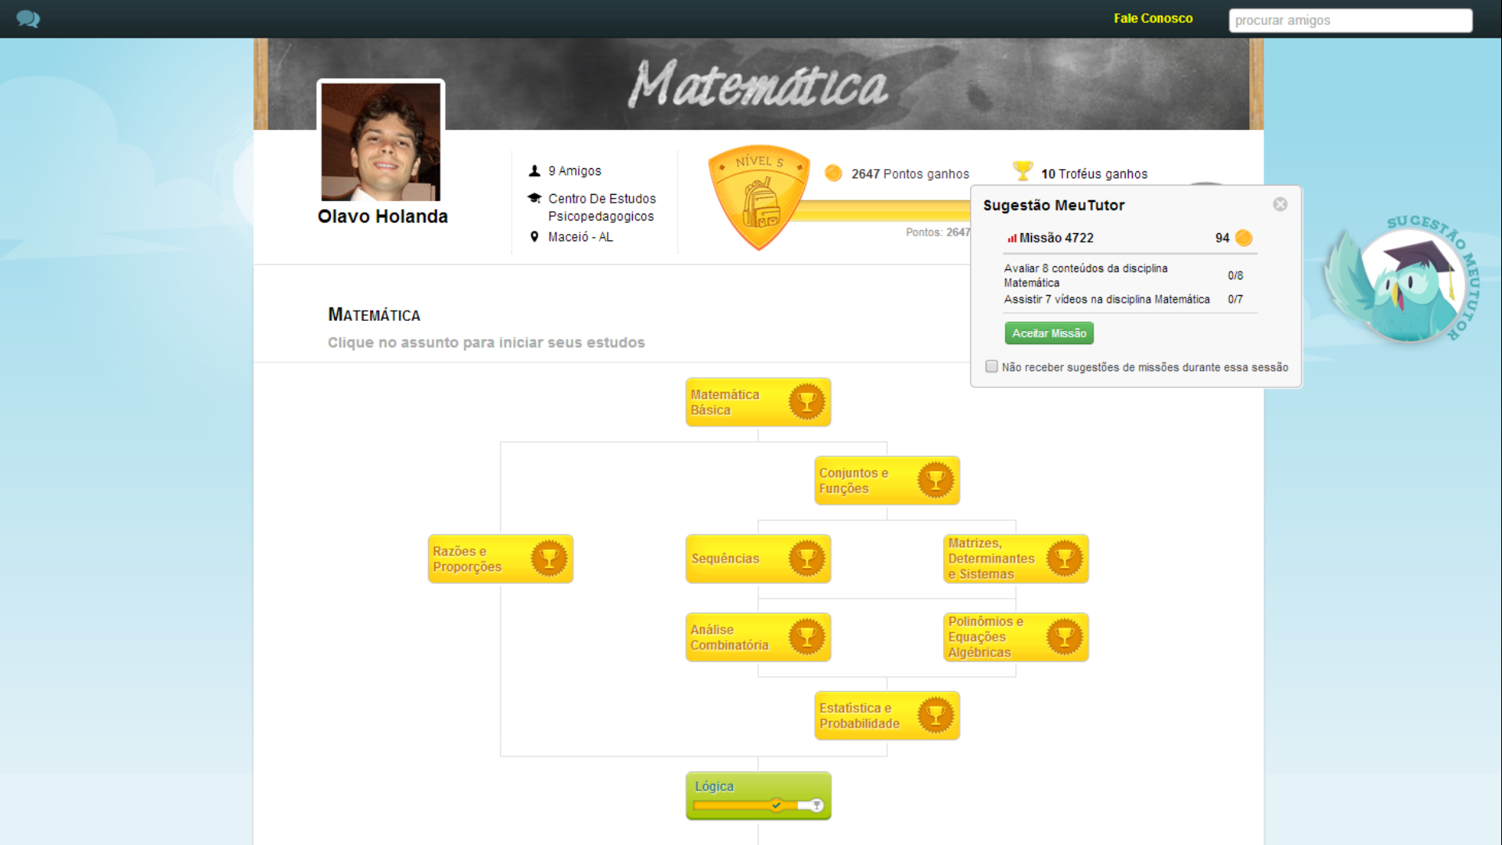

Slide 68
Gamification
Intelligent Tutoring Systems
Optimal Learning Experience

Slide 69
How to tackle the problem ?
Optimal Learning Experience
Designing Gamified Tasks
Designing Stereotyped Gamified Environments
Promotes
Avoids

Slide 70
How to tackle the problem ?
Optimal Learning Experience
Designing Gamified Tasks
Promotes

Slide 71
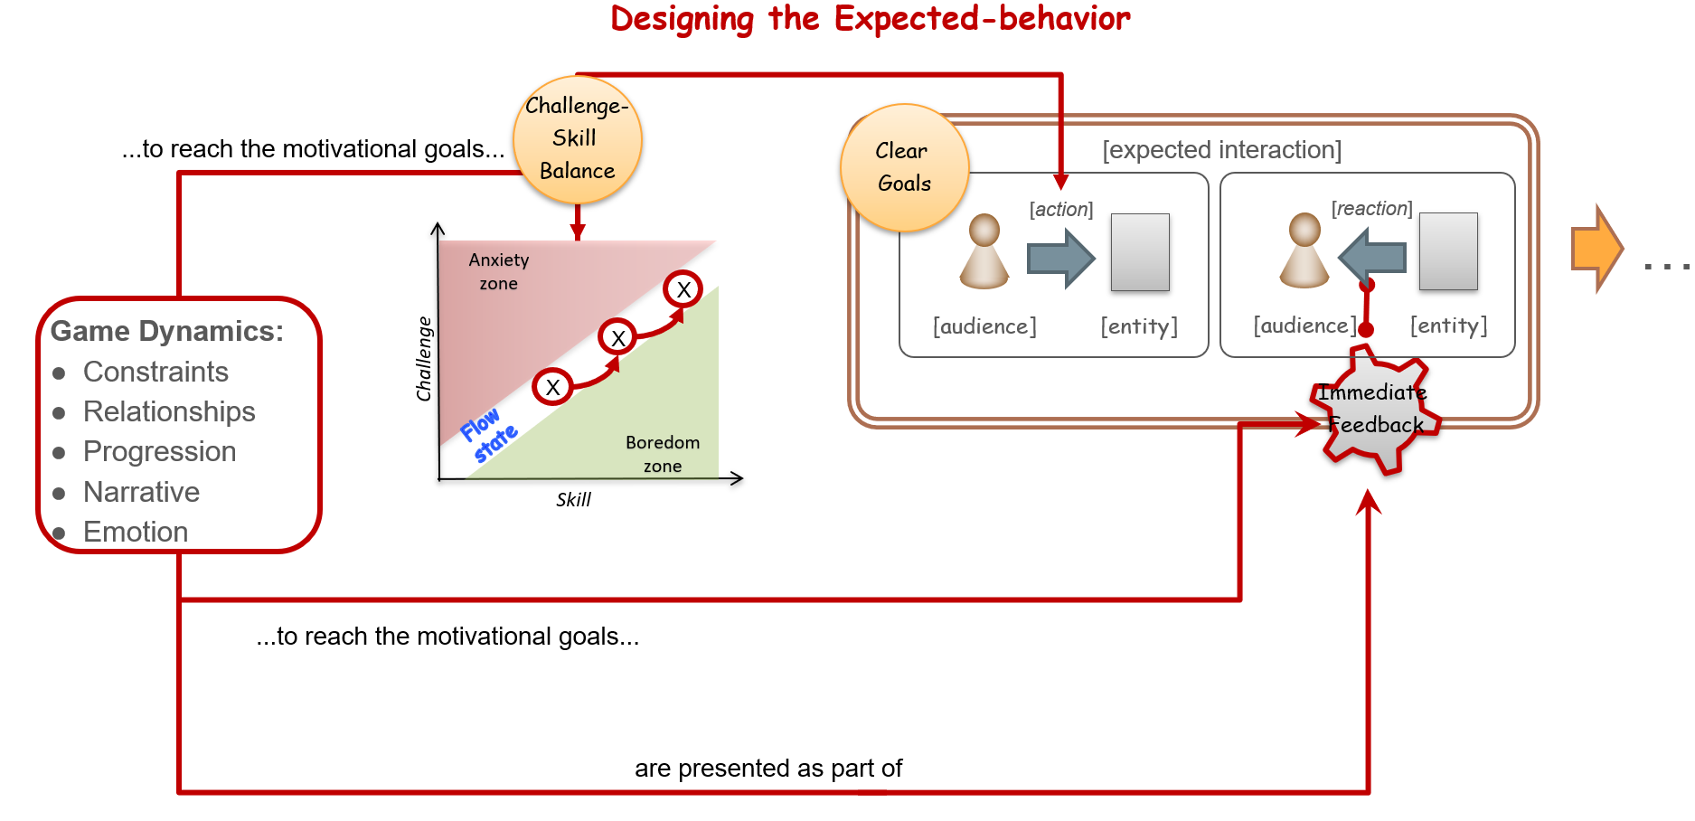
Designing gamified tasks to achieve Flow - GamiFlow

Slide 72

Clear objective and short-term goals
Additional mechanics defined to align game-dynamics for player profiles
[Expected interaction]
[action]
[response]
…
…
[entity]
[entity]
Game
Mechanics:
[target]
[target]
Challenges
Feedback
clear&direct
Reward
Game
Components:
Achievements
Mission
Levels
Boss fights
Comp. 01
(Progress bar)
Comp. 02
...
Additional components defined to align game-dynamics for player profiles

Slide 73
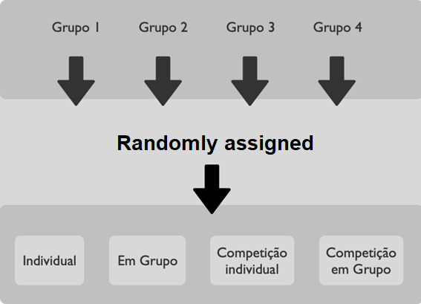
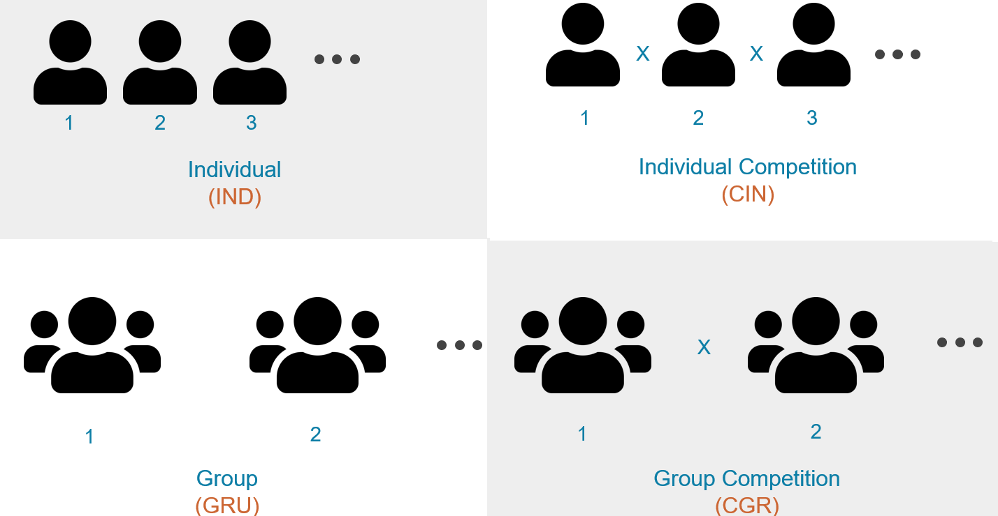
Designing gamified tasks to achieve Flow

Slide 74

Designing gamified tasks to achieve Flow

Slide 75
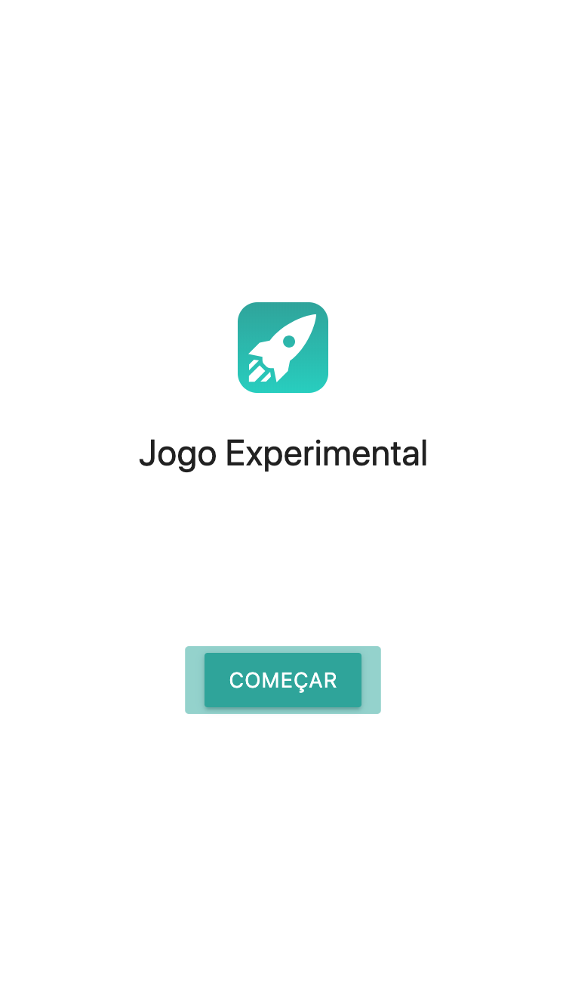
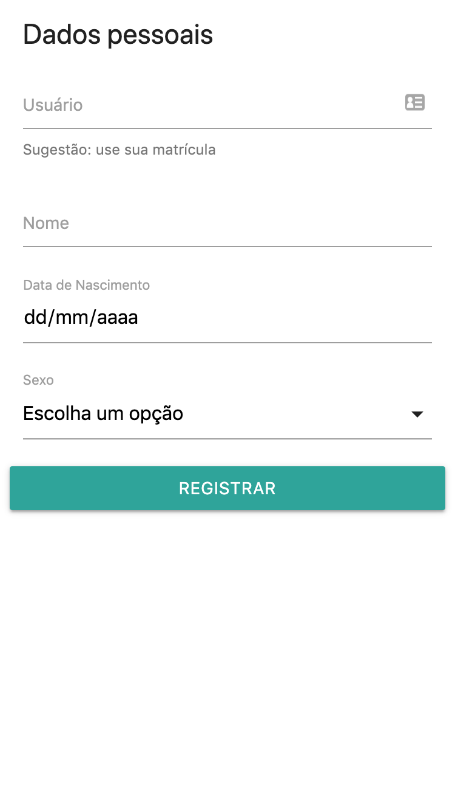


Designing gamified tasks to achieve Flow

Slide 76

Designing gamified tasks to achieve Flow

Slide 77

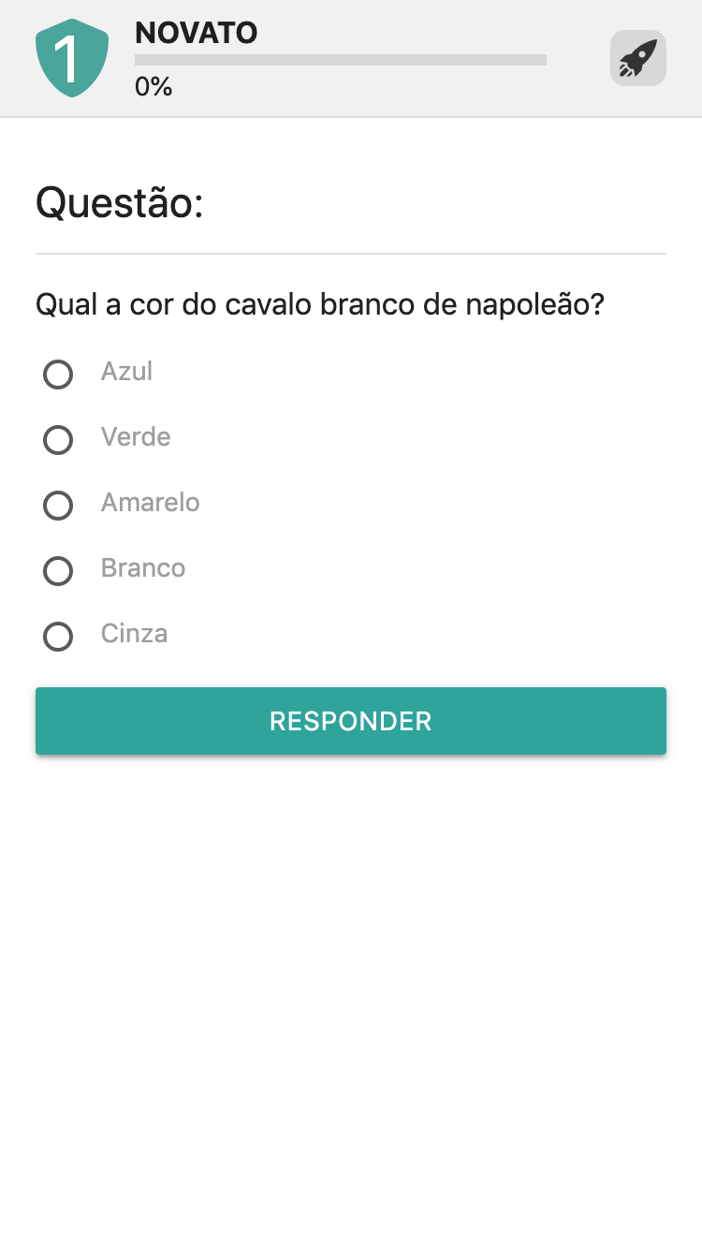


Designing gamified tasks to achieve Flow - Context

Slide 78

Designing gamified tasks to achieve Flow - Dynamics
Level
Classification
Challenge
Progression

Slide 79
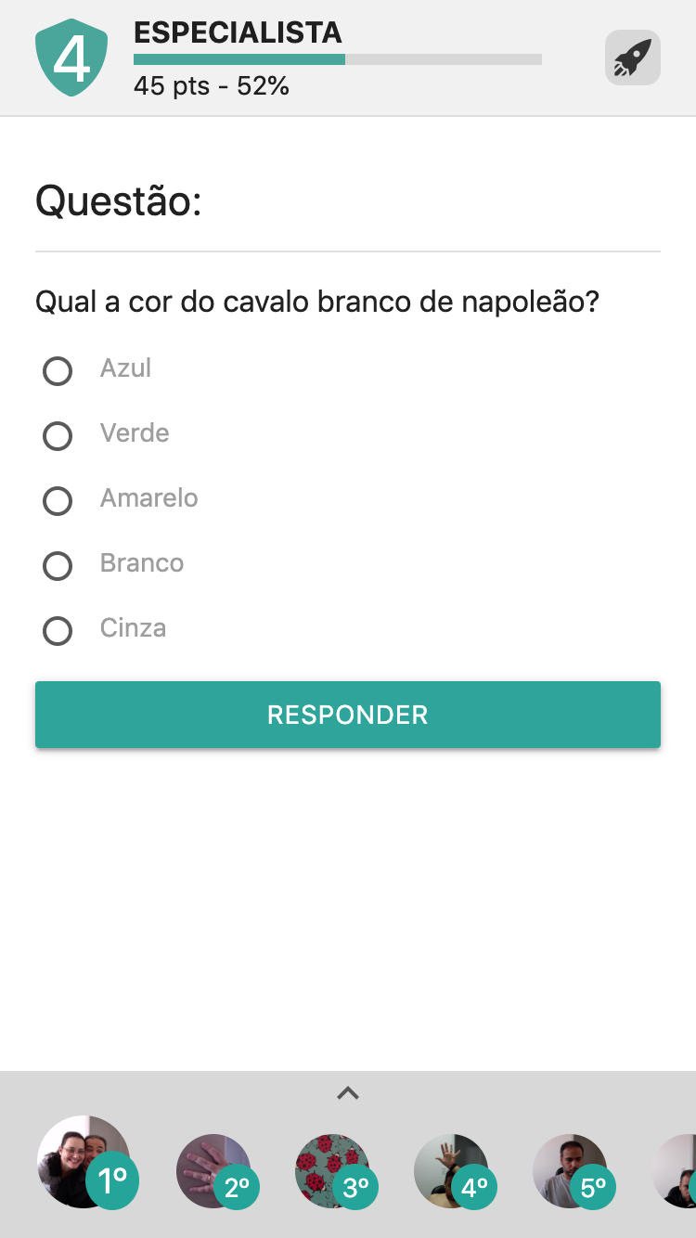
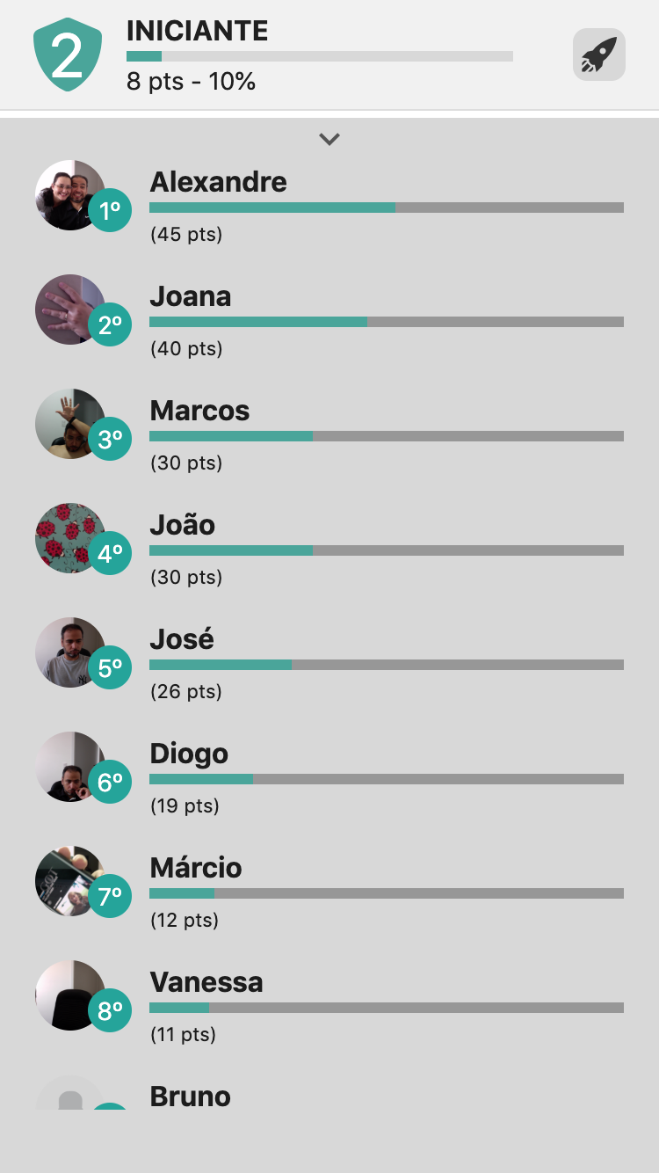
Designing gamified tasks to achieve Flow - Competition

Slide 80
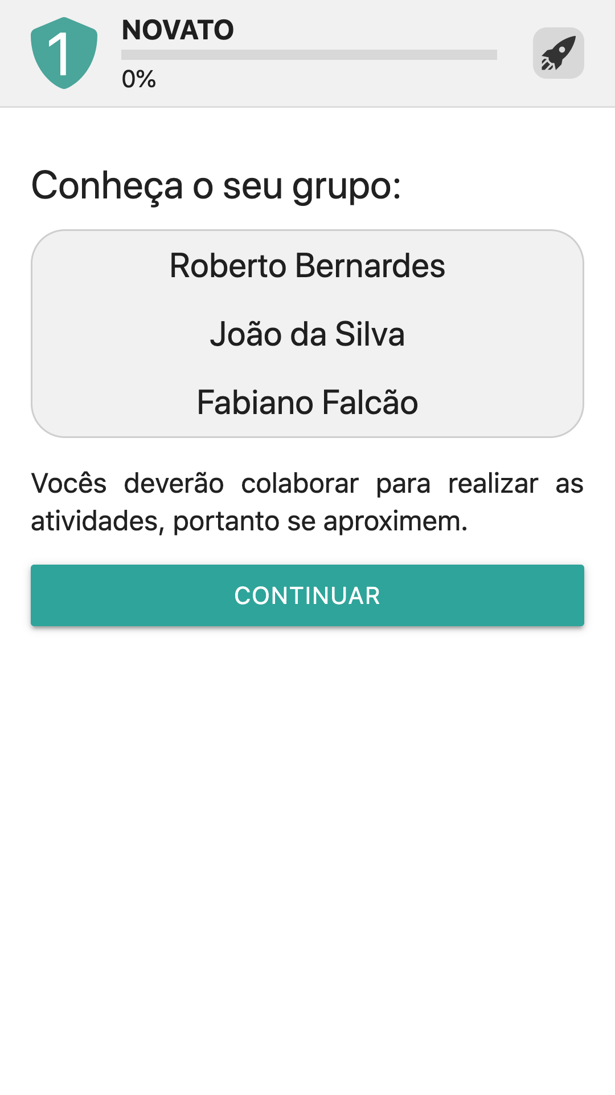

Designing gamified tasks to achieve Flow - Collaboration

Slide 81

Designing gamified tasks to achieve Flow - Questionnaire

Slide 82





Slide 83
Designing gamified tasks to achieve Flow
Competition (p = .171) and Collaboration (p = .358) does not affect the flow experience
Interaction of Competition and Collaboration promotes the flow experience (p = .008)
Competition lead students to more answers and errors
No correlation between Player Types and Flow Experience

Slide 84
How to tackle the problem ?
Optimal Learning Experience
Designing Gamified Tasks
Promotes

Slide 85
How to tackle the problem ?
Optimal Learning Experience
Designing Stereotyped Gamified Environments
Avoids

Slide 86

Designing stereotyped gamified environments
SILVA, J. ; Bittencourt, I.I.; et al. Does gender stereotype threat in gamified educational environments cause anxiety? An experimental study. COMPUTERS & EDUCATION, v. 115, p. 161-170, 2017.

Slide 87

Designing stereotyped gamified environments
SILVA, J. ; Bittencourt, I.I.; et al. Does gender stereotype threat in gamified educational environments cause anxiety? An experimental study. COMPUTERS & EDUCATION, v. 115, p. 161-170, 2017.

Slide 88

Designing stereotyped gamified environments

Slide 89

Designing stereotyped gamified environments
SILVA, J. ; Bittencourt, I.I.; et al. Does gender stereotype threat in gamified educational environments cause anxiety? An experimental study. COMPUTERS & EDUCATION, v. 115, p. 161-170, 2017.

Slide 90
General Motivation
Basic Theoretical Foundations
Designing for Optimal Experience
Challenges
Research Agenda

Slide 91
Frustration
X
X
X
X
X
X
Perceived Level of Challenge
X
Flow
X
X
X
Boredom
Perceived Level of Ability

Slide 92
General Motivation
Basic Theoretical Foundations
Designing for Optimal Experience
Challenges
Research Agenda

Slide 93
Grand Challenge: How the design and use of educational systems can promote an optimal learning experience ?
Phase 1 (Basic Research): Instrument validation & Small-scale experiments
Validation of Flow and Gamification Questionnaires (Long and Short DFS-2 and GAMEFULQUEST)
Machine Learning Algorithm(s) for Stereotyped Learning and Gamified Systems
Design Gamified Tasks to Small-scale experiments
GamiFlow validation
Phase 2 (In Vivo Studies): Small-scale studies (students and classrooms)
GamiFlow and stereotyped gamification empirical studies
EEG studies*
Flow Detectors
Phase 3 (In Situ Studies): Large-scale studies (schools and A/B tests)
GamiFlow and non-stereotyped gamification experiments
Re-Design of Commercial Learning Environments
Phase 4 (Cross-Cultural Studies and Innovation): Very Large-scale studies (BRICS + Europe)
GamiFlow and non-stereotyped gamification experiments
Technology Transfer

Slide 94
Thank you!
Ig Ibert Bittencourt – ig.ibert@ic.ufal.br

